Slide 1

Protective clothing AND FACTS
From the English civil war

Slide 2
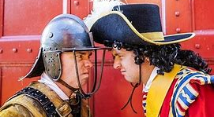
Roundhead Cavaliers

Slide 3

FACT ABOUT THE ROUNDHEADS
. Many of the Roundheads shaved off there hair.
. They called themselves The New Model Army.
. They spent lots of time training because they cared about the English Civil War.
. They wore simple practical clothing in battle, along with metal helmets and breastplates.
. The Army included farmer but also recruited from the tuns and contained merchant shopkeepers too.

Slide 4
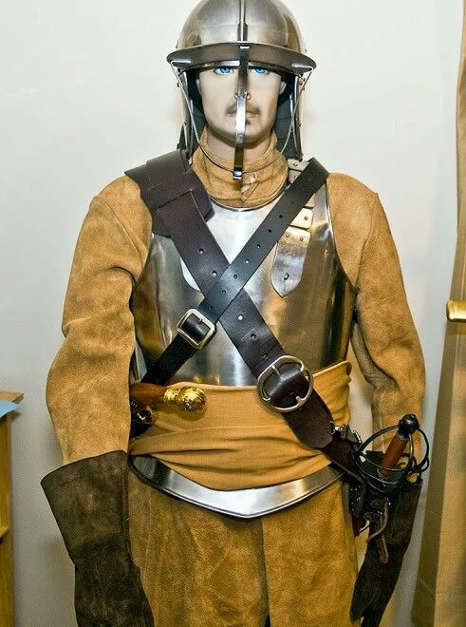
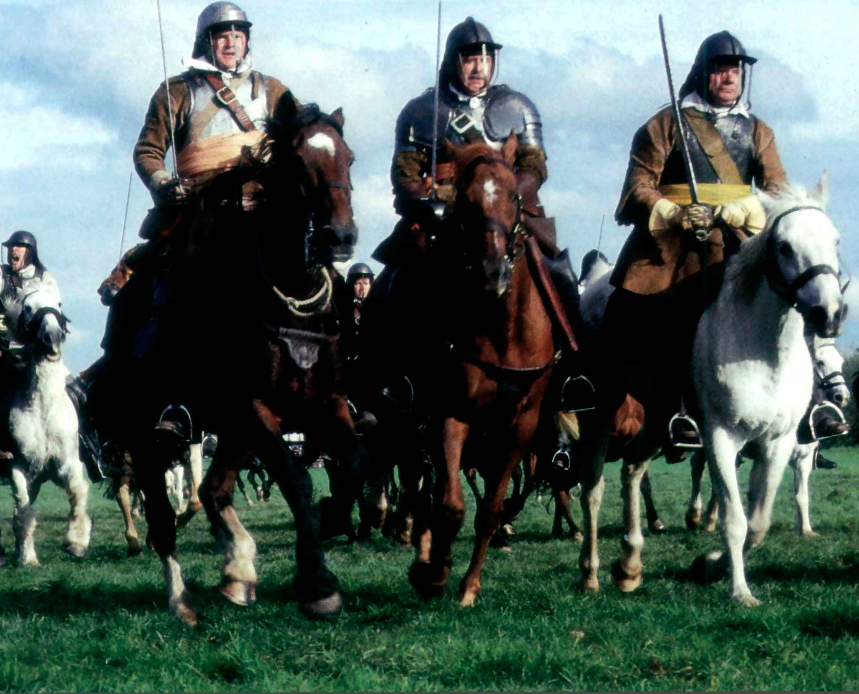

Slide 5
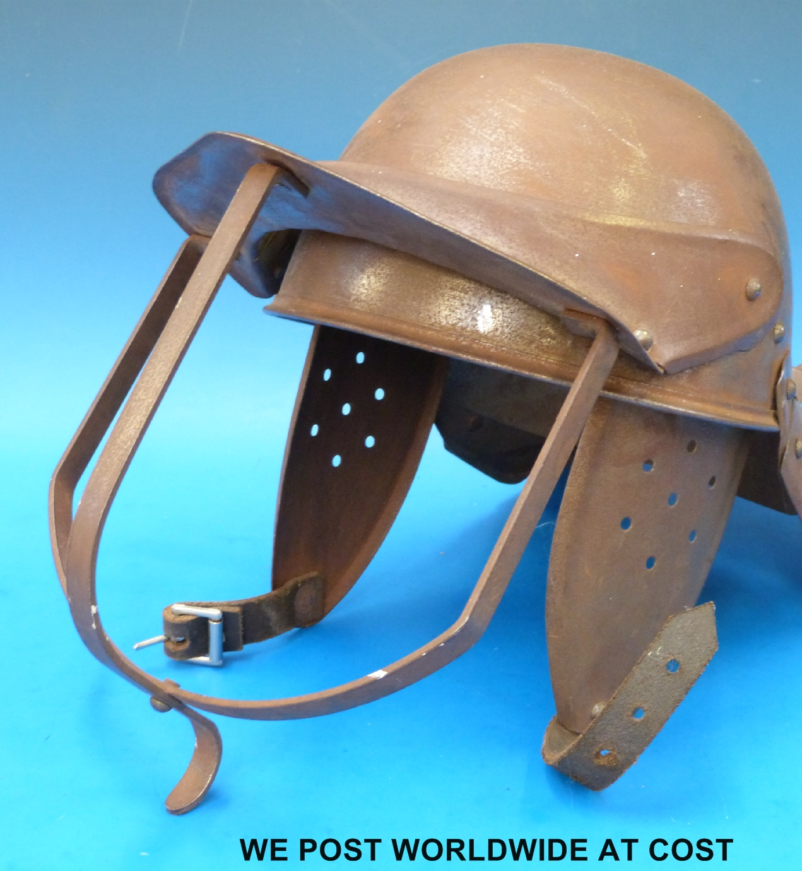
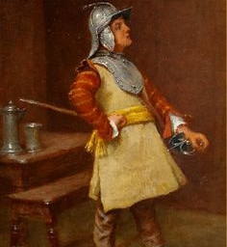

Slide 6
FACTS ABOUT THE CAVALIERS
They supported the king as they belived he was choosen by god
They called themselves the royalists
Most the army are landowners so are rich
They didn’t care as much about the battle as the roundheads
They had long hair and wipsy moustache
They wore expensive silk clothes to battle and wore a feather in their hats
They didn’t have much to protect them at battle

Slide 7
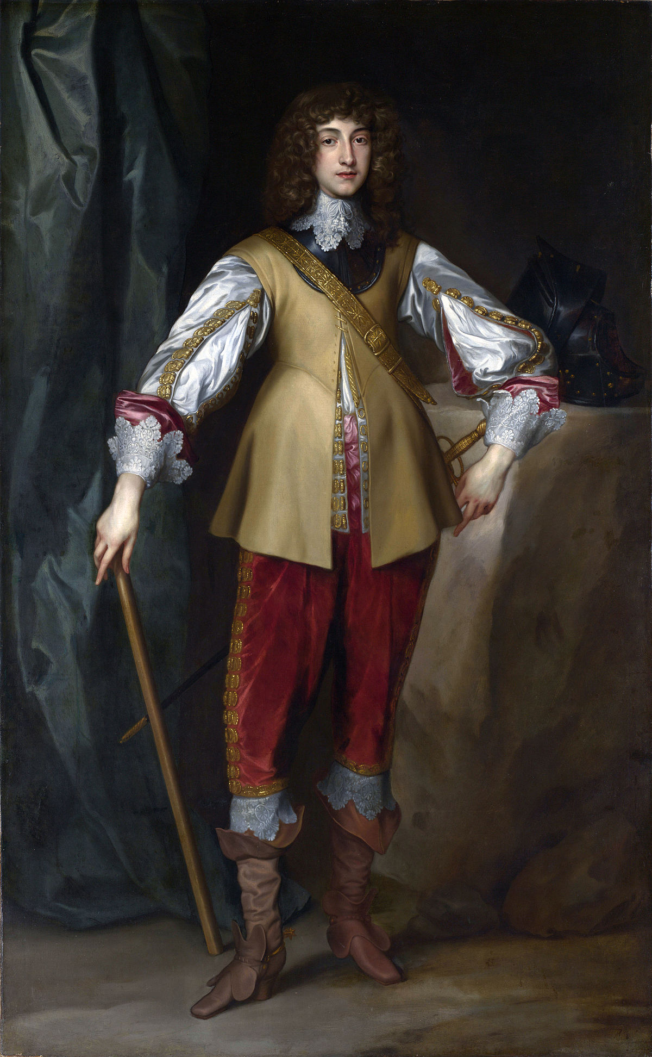
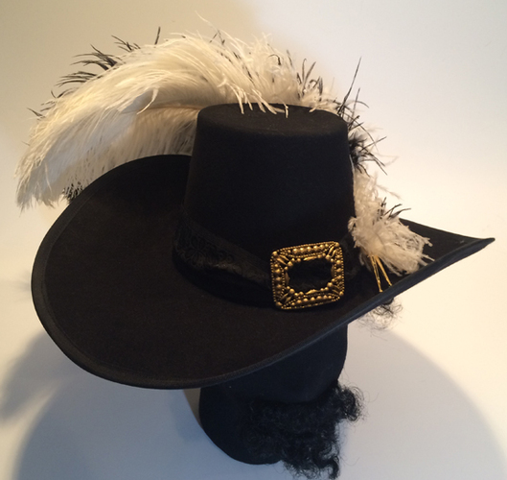

Slide 8



