Slide 1
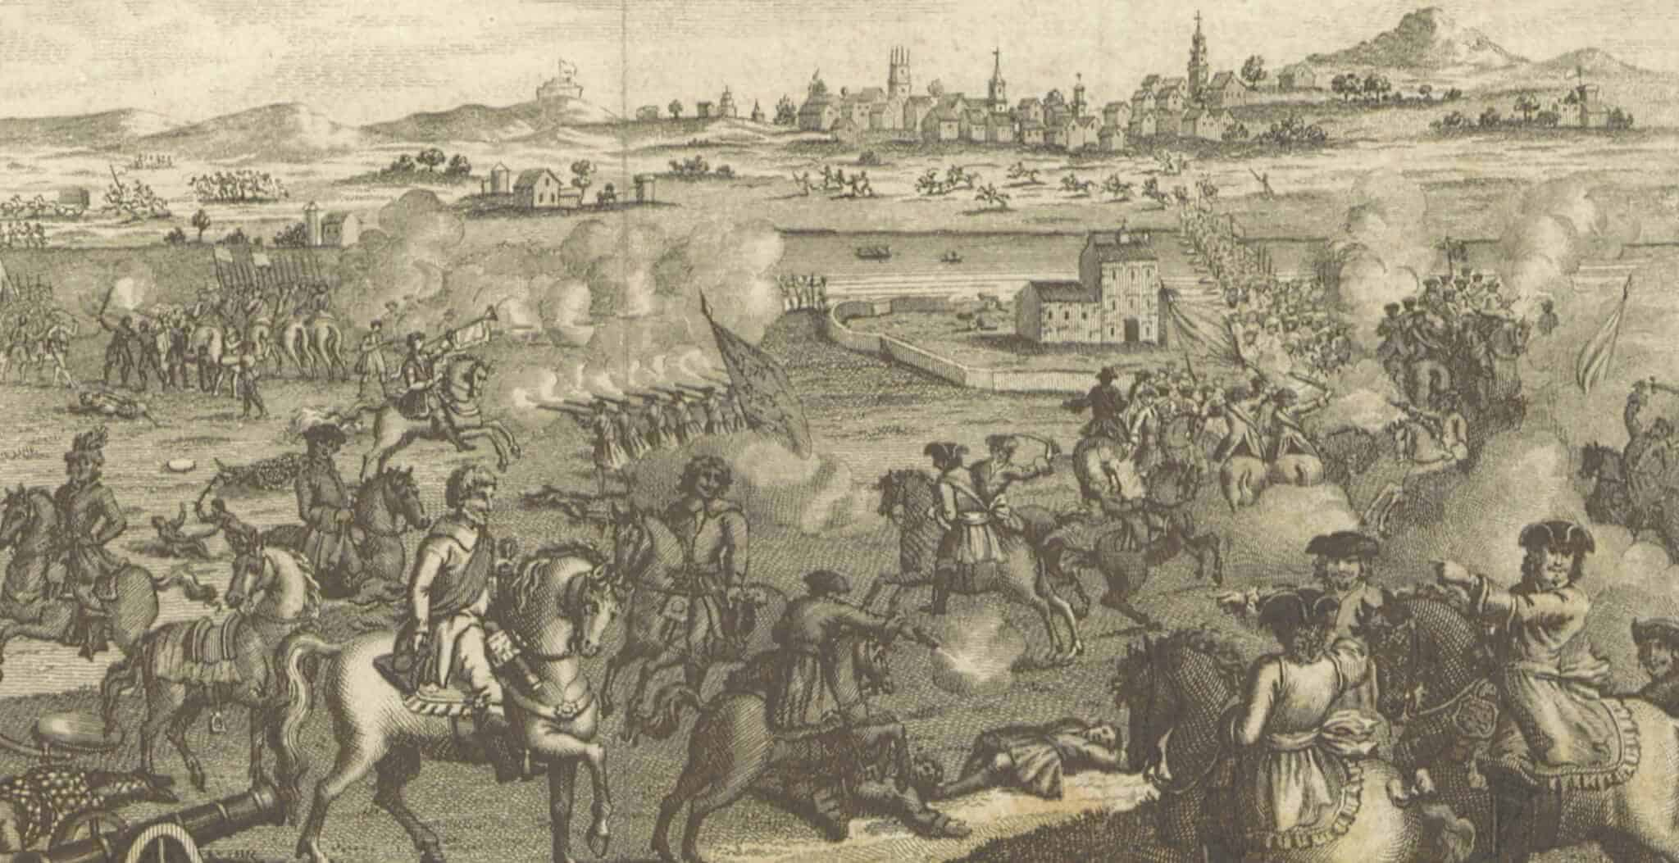
THE BATTLE OF WORCESTER
3rd September 1651

Slide 2
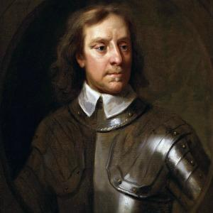
ROUNDHEADS
This is Oliver Cromwell the leader of the Parliamentarian army called the Roundheads. In his army he has 28,000 men. He trained his men long and hard so they could be better, fitter and stronger than the Cavaliers so he could win and defeat King Charles II. Only 200 of his army sadly died. The Roundheads wore heavy metal armer along with some big brown boots that covered their whole legs for extra protection. They wore strong metal helmets to protect their heads they also had cream sashes and a belt to hold all of their weapons in. Underneath all of that they wore a cream coat. Oliver Cromwell's army shaved all of their hair off which is why their nick name is the Roundheads. The Roundheads flag is a blue oval shape split down the middle. On one side there is a picture of a harp and on the other there is a white background with a red cross on it. The Roundheads didn’t want any Kings or Queens.

Slide 3
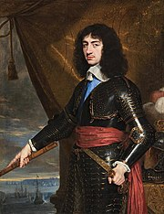
CAVALIERS
This is King Charles II the second leader of the Cavaliers the first leader (King Charles I who is King Charles II dad) got executed. King Charles II army were called the Cavaliers. The Cavaliers had 12,000 men that is another reason why they lost along with partying. The Cavaliers always partied because they wanted to be happy for the last few days of life. The Cavaliers wore a big hats in a lovely light blue colour with a scarlet red feather in it. They also wore big brown boots just going over their knees. They had a cream coat like the Roundheads with a dark blue sash around their waist. Instead of having no hair like the Roundheads the Cavaliers had lots of curly, long brown hair. King Charles II ran and hid up an old oak tree while the battle was going because he was so scared of Oliver Cromwell and his army. After that, he fled to France as he lost and was still so terrified. 3,000 of the Cavaliers sadly died while the 10,000 survivors got captured. The Cavalier flag is square with the colours red, blue and yellow, with a lion, a harp and three leaves tied together in a knot.

Slide 4
QUIZ TIME!
1.
2. Who is the leader of the Roundheads?
3. Who is the leader of the Cavaliers?
4. Who got executed?
5. Which army won?
6. Which country did King Charles II escape to?
7. What was the last battle called?
8. What tree did King Charles II hide in?
What day did the Battle of Worcester start?

Slide 5
ANSWERS
3rd September 1651
Oliver Cromwell
King Charles II
King Charles I
Roundheads
France
Battle of Worcester
Oak tree

