Slide 1
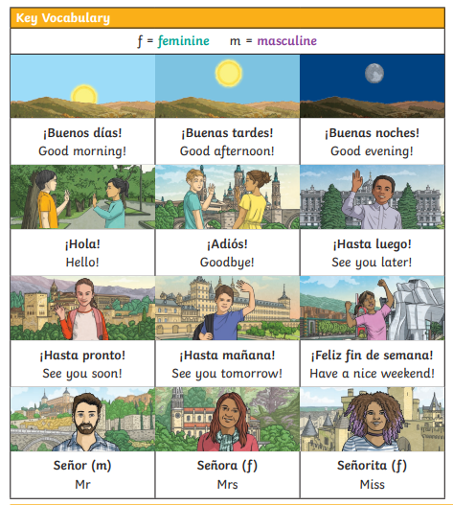
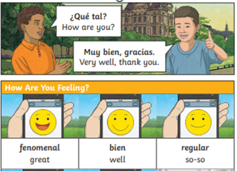
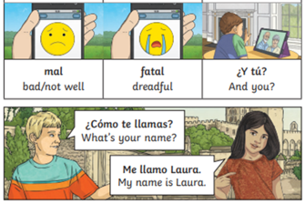
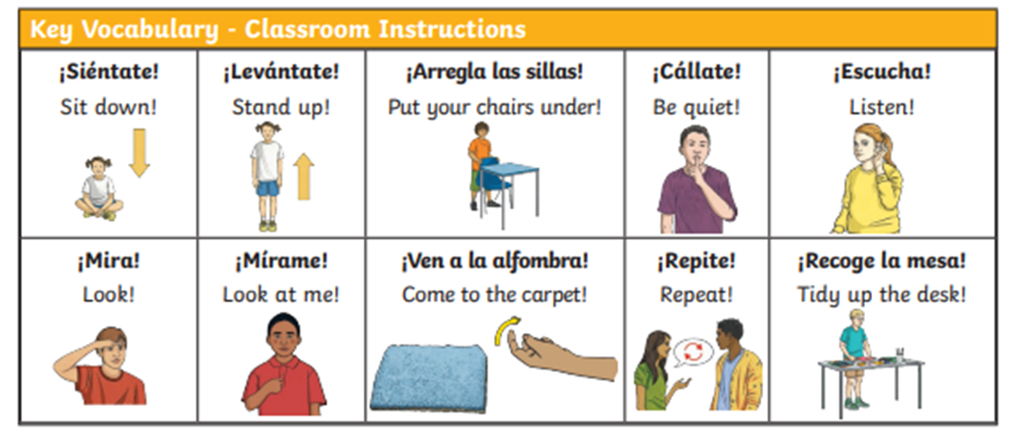
Lyppard Grange Primary School: Spanish Knowledge Organiser
Year 3 Unit 1: Autumn Term | Bienvidos a Espaňa (Welcome to Spain!)

Slide 2
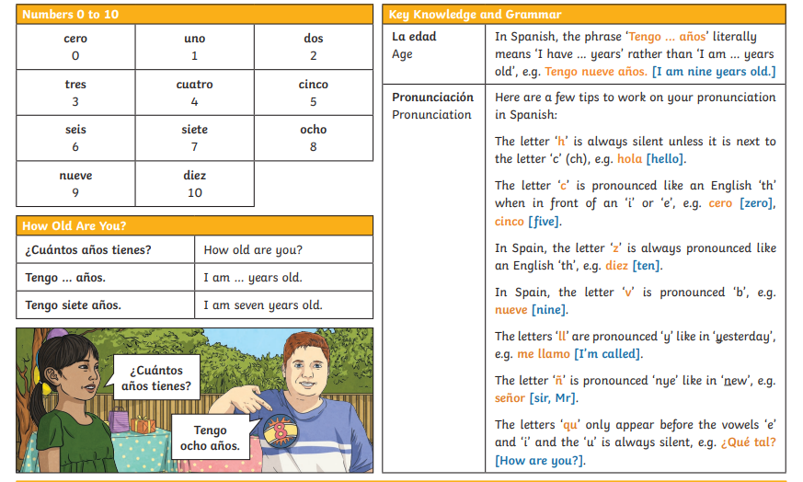
Lyppard Grange Primary School: Spanish Knowledge Organiser
Year 3 Unit 1: Autumn Term | Bienvidos a Espaňa (Welcome to Spain!)

Slide 3
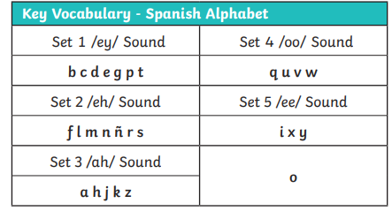
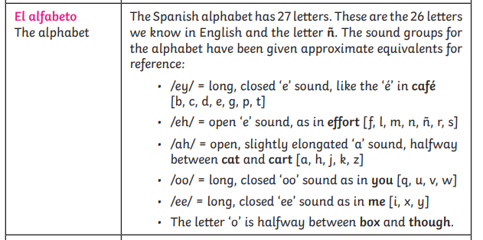
Lyppard Grange Primary School: Spanish Knowledge Organiser
Year 3 Unit 1:Autumn Term | Bienvidos a Espaňa (Welcome to Spain!)
The Spanish Alphabet – What you need to know!
This follows on from: | This leads to:
Vocabulary: Information about themselves This is the first term children study Spanish. | Vocabulary: Information about themselves Year 3 Spring Term - When is your birthday?
Grammar No grammar taught until Summer Term Year 3 | Grammar No grammar taught until Summer Term Year 3

Slide 4
Lyppard Grange Primary School: Spanish Knowledge Organiser
Year 3 Unit 1: Autumn Term | Bienvidos a Espaňa (Welcome to Spain!)
What do we want children to know and do by the end of the unit?
Key Knowledge: Vocabulary Be able to greet someone is Spanish. To ask someone how they are feeling and say how they are feeling. To know numbers 01-10. To ask for and give your age. To say the Spanish alphabet. Key Skills: Speaking and Listening To begin to use correct pronunciation in spoken work To listen to spoken words.
How to progress through the unit. *Please ensure there is evidence of each stage in Pink Spanish Books. *When introducing new vocabulary print off a list and stick it into their books for future use.
Step 1: Introduce the children to key vocabulary – they need during the topic. This can be done through songs, games, word searches, listening games, labelling, ICT based activities, drawing and colouring (or anything else you think may make this interesting. *Scheme Link: Y3 lessons 1,2,4 and 5 you will find ideas and resources for this in the folders in PPA room or on staff share subject leader/Spanish/curriculum 2023-2024/scheme resources
Step 2: Children listen to and look at a range of simple meet and greet conversations and be encouraged listen for or read any words they know. They should be encouraged to look and listen for familiar words/phrases in order to get the meaning the whole sentence. Teachers will need to model simple techniques skills and they will need to give the children time to practice their skills using other phrases based on the model used in whole class teaching.

