Slide 1
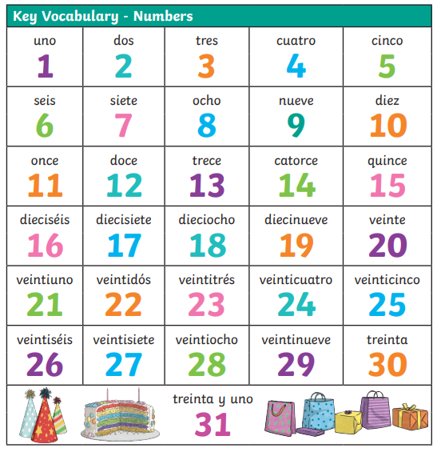
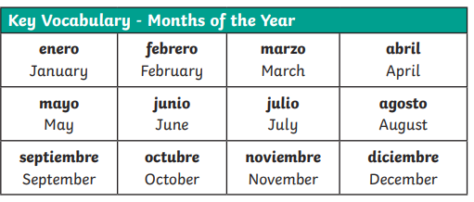
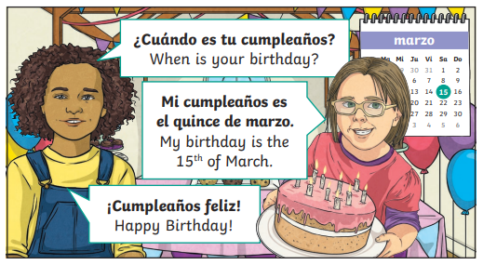

Lyppard Grange Primary School: Spanish Knowledge Organiser
Year 3 Unit 2:Spring Term | Dias y meses (Days and Months)

Slide 2
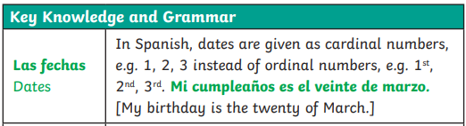
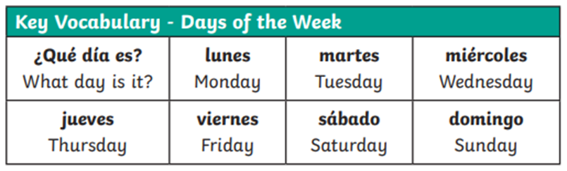
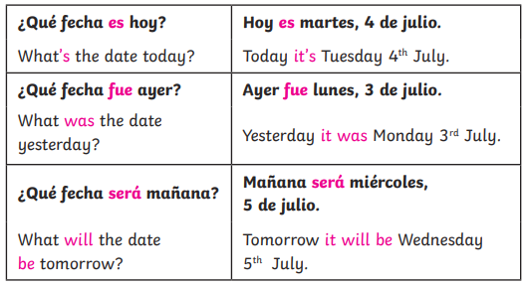
Lyppard Grange Primary School: Spanish Knowledge Organiser
Year 3 Unit 2: Spring Term | Dias y meses (Days and Months)
This follows on from: | This leads to:
Vocabulary: Information about themselves Year 3 Autumn Term – Welcome to Spain | Vocabulary: Information about themselves Year 4 Autumn Term – Meet my family.
Grammar No grammar taught until Summer Term Year 3 | Grammar No grammar taught until Summer Term Year 3

Slide 3
Lyppard Grange Primary School: Spanish Knowledge Organiser
Year 3 Unit 2: Srping Term | Dias y meses (Days and Months)
What do we want children to know and do by the end of the unit?
Key Knowledge: Vocabulary To say numbers from 10-31 To recite the days of the week To recite the months of the year To say when their birthday is. To ask and answer what the date is today, yesterday and tomorrow. Key Skills Speaking and Listening Listen to and respond to familiar spoken words. Reading Recognise some familiar words in their written form
How to progress through the unit. *Please ensure there is evidence of each stage in Pink Spanish Books. *When introducing new vocabulary print off a list and stick it into their books for future use.
Step 1: Introduce the children to key vocabulary – they need during the topic. This can be done through songs, games, word searches, listening games, labelling, ICT based activities, drawing and colouring (or anything else you think may make this interesting. *Scheme Link: Y3 lessons 3,5,9,10 and 11 you will find ideas and resources for this in the folders in PPA room or on staff share subject leader/Spanish/curriculum 2023-2024/scheme resources
Step 2: Children listen to and look at a range of simple conversations which involve children asking and answering what they date is or when their birthday is and be encouraged listen for or read any words they know. They should be encouraged to look and listen for familiar words/phrases in order to get the meaning the whole sentence. Teachers will need to model simple techniques skills and they will need to give the children time to practice their skills using other phrases based on the model used in whole class teaching.
Step 3: Children to be introduced to writing in Spanish – they begin to start writing the date each session and to write when their birthday is. Children should be supported to achieved this by using modelled phrases and fill in the gap activities.

