Slide 1
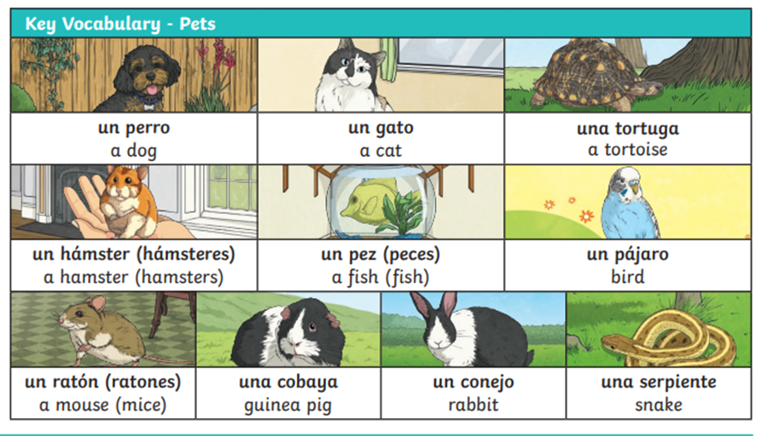
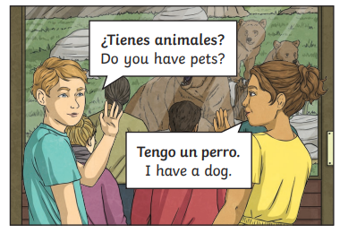
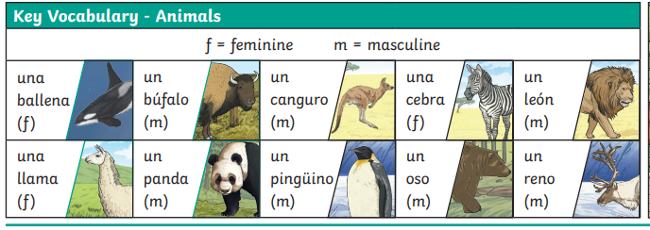


Lyppard Grange Primary School: Spanish Knowledge Organiser
Year 3 Unit 3: Summer Term | animales (Animals)
Additional Vocabulary Verbs

Slide 2
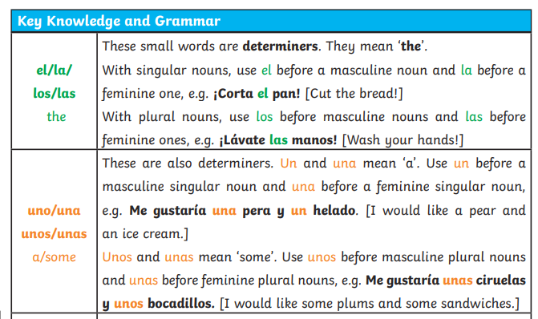
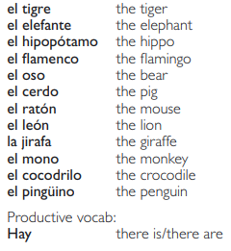
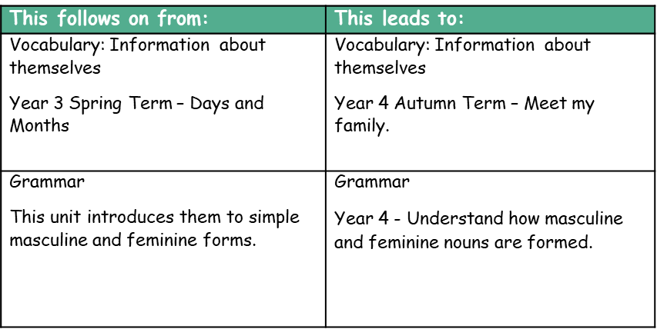
Lyppard Grange Primary School: Spanish Knowledge Organiser
Year 3 Unit 3: Summer Term | animales (Animals)
What do we want children to know and do by the end of the unit?
Key Knowledge: Vocabulary To Know the names for animals and pets . Grammar Recognise masculine and feminine forms of key vocabulary Key Skills Speaking and Listening Communicate with others using familiar spoken words Reading To read and understand some familiar words in written form Writing To write some familiar words using a model
Additional Vocabulary- Zoo Animals.

Slide 3
Lyppard Grange Primary School: Spanish Knowledge Organiser
Year 3 Unit 3: Summer Term | animales (Animals)
How to progress through the unit. *Please ensure there is evidence of each stage in Pink Spanish Books. *When introducing new vocabulary print off a list and stick it into their books for future use.
Step 1: Introduce the children to key vocabulary – they need during the topic. This can be done through songs, games, word searches, listening games, labelling, ICT based activities, drawing and colouring (or anything else you think may make this interesting. This includes introducing them to the concept of masculine and feminine nouns. Children to undertake sorting activites to emonstrate their understanding of masculine and feminine nouns. This is to be recordrd in pink books. *Scheme Link: Y4 lessons 4, 10 and 11 you will find ideas and resources for this in the folders in PPA room or on staff share subject leader/Spanish/curriculum 2023-2024/scheme resources
Step 2: Zoo Animals –Reading They should be encouraged to look and listen for familiar words/phrases in order to get the meaning the whole sentence. Teachers will need to model simple techniques skills and they will need to give the children time to practice their skills using other phrases based on the model used in whole class teaching. *Scheme Link: Y4 lessons 4, 10 and 11 you will find ideas and resources for this in the folders in PPA room or on staff share subject leader/Spanish/curriculum 2023-2024/scheme resources
Step 3: Children to be introduced to writing in Spanish – they write a sentence about their pets. Children should be supported to achieved this by using modelled phrases and fill in the gap activities.

