Slide 1
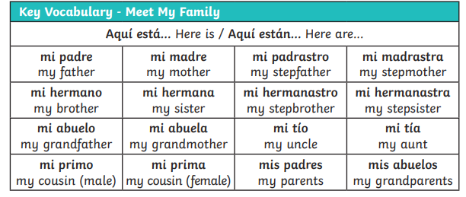
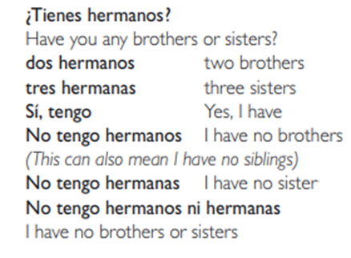
Lyppard Grange Primary School: Spanish Knowledge Organiser
Year 4 Unit 1: Autumn Term | Meet my family
What do we want children to know and do by the end of the unit?
Key Knowledge Vocabulary Be able to say the Spanish for family members. Grammar Be able to say the names of the family using and knowing when to say la or el. Understand the basic plural rules (adding s) Key Skills: Speaking and Listening: Communicate by answering a range of questions Reading: Read and show understanding of simple phrases and sentences containing familiar words. Writing: Copy simple familiar words to describe people, using a model
Additional Vocabulary – Meet my Family
Spanish Grammar – What you need to know!
Verbs: In Spanish, verbs change according to every subject. The key verbs for this term are: tengo - I have tienes - you have Tip! When you want to make a sentence negative, simply add no before a verb. E.g. No tengo hermanos . [I have no brothers]. | Masculine and Feminine Forms This term builds how we use masculine and feminine forms within nouns. El hermano – a brother (not only has the masculine determiner of el but also ends in an o) La hermana – a sister (has the feminine determiner but end in an a) La madre/el padre – a mum/a dad (both end in e ansd this does not change – the determiner tells us whether it is a masculine or feminine noun.

Slide 2
Lyppard Grange Primary School: Spanish Knowledge Organiser
Year 4 Unit 1: Autumn Term | Meet my family
This follows on from: | This leads to:
Vocabulary: Information about themselves Year 3 Unit 2– My birthday | Vocabulary: Information about themselves Year 5 – Autumn Term – My hobbies
Grammar Year 3 unit 3: Recognise masculine and feminine formsof nouns | Grammar Year 5 - Begin to understand how the noun changes when it is written in the masculine and feminine form
How to progress through the unit. *Please ensure there is evidence of each stage in Pink Spanish Books. *When introducing new vocabulary print off a list and stick it into their books for future use.
Step 1: Introduce the children to key vocabulary – they need during the topic (see knowledge organiser). This can be done through songs, games, word searches, listening games, labelling, ICT based activities, drawing and colouring (or anything else you think may make this interesting. This is where you can teach the grammar – focusing on the concepts of masculine and feminine nouns and how the final letter change between o and a based on the whether the noun is masculine or feminine. You can begin to introduce the position of adjectives in words. *Scheme Link: Y4 lesson 8,9 – you will find ideas and resources for this in the folders in PPA room or on staff share subject leader/Spanish/curriculum 2023-2024/scheme resources
Step 2: Provide the children with opportunities to read and translate the new material in simple sentences (one or two sentences). This should be made up sentences that children in other schools have written about their own family e.g. I have two sisters. Pets need to be included here as they the knowledge to build this in from summer term Year 3. They should be encouraged to look for familiar words/phrases in order to translate the whole sentence. Teachers will need to model simple translation skills and they will need to give the children time to practice their skills using other sentences based on the model used in whole class teaching.
Step 3: Provide the children with opportunities to write using a combination of new material and known language in simple sentences (2-3 sentences) using the text translated in previous sessions as a model. This should be simple sentences about their own family and pets. Teachers will need to model writing 2-3 sentences as a model text (use-translated texts in previous sessions as a model). The children need to write their own text (2-3 sentences). The support group would need a copy of the text in front of them to just change key points.

