Slide 1
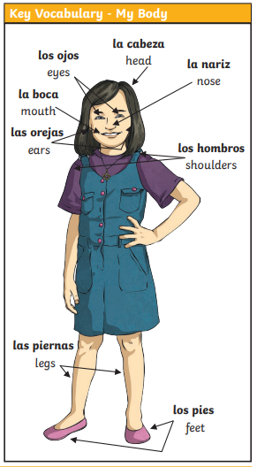
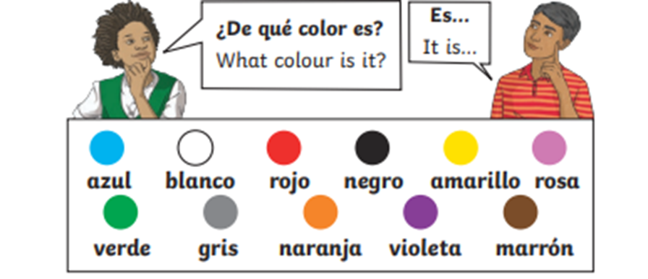

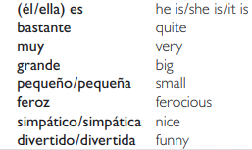
Lyppard Grange Primary School: Spanish Knowledge Organiser
Year 4 Unit 2: Spring Term | El Monstruo: The Monster (colours, my body)
What do we want children to know and do by the end of the unit?
Key Knowledge: Vocabulary Be able to say the colours in Spanish Be able to say the body parts in Spanish Be able to say simple adjectives in Spanish Grammar Be able to say the names of the family using and knowing when to say la or el. Understand the basic plural rules (adding s) Key Skills: Speaking and Listening: Listen to and identify known words in short phrases Reading: Read and show understanding of simple phrases and sentences containing familiar words and make links with English or other known languages to work out unfamiliar words. Writing: Write a simple phrase that may contain an adjective to describe people, places, things and actions using a scaffold
Additional Vocabulary – El Monstruo
Additional Vocabulary – El Monstruo

Slide 2
Lyppard Grange Primary School: Spanish Knowledge Organiser
Year 4 Unit 2: Spring Term | El Monstruo: The Monster (colours, my body)
This follows on from: | This leads to:
Vocabulary: Daily Life Year 3 Unit 3: Summer Term – Animals and Pets | Vocabulary: Daily Life Year 4 Summer Term – The Café.
Grammar Year 4 unit 1: To explain why el or la is used before a noun. | Grammar Year 5 - Begin to understand how the noun changes when it is written in the masculine and feminine form
Spanish Grammar – What you need to know!
Adjectives (In sentences) In English we create sentences placing the adjective before the noun. A small mouth In Spanish sentences are created by placing the adjective after the noun La bocha pequena bocha (mouth) pequena (small) *It is important to emphasise that in many languages the children will learn during their time in education the adjectives comes after the noun e.g French and Italian. It is also worth asking if children speak any other languages at home and comparing those languages. | Adjectives (Masculine and Feminine Forms) *Year 5 objective but can be introduced if some children are ready In Spanish, because nouns have a gender (see Year 3 Knowledge Organisers) any adjectives applied to them have to ‘agree’ grammatically. La bocha pequena – a small mouth (mouth is a feminine noun so the ending of the adjective must be an a). El ojo pequeno – a small eye (eye is a masculine noun so the ending must be an o). There are some adjectives (grande) that always end in e both in the masculine and feminine form.

Slide 3
Lyppard Grange Primary School: Spanish Knowledge Organiser
Year 4 Unit 2:Spring Term | El Monstruo: The Monster (colours, my body)
How to progress through the unit. *Please ensure there is evidence of each stage in Pink Spanish Books. *When introducing new vocabulary print off a list and stick it into their books for future use.
Step 1: Introduce the children to key vocabulary – they need during the topic. This can be done through songs, games, word searches, listening games, labelling, ICT based activities, drawing and colouring (or anything else you think may make this interesting. This is where you can teach the grammar – focusing on the concepts of masculine and feminine nouns and how the final letter change between o and a based on the whether the noun is masculine or feminine. You can begin to introduce the position of adjectives in words. *Scheme Link: Y3 lesson 6,7 /Scheme Link: Y4 lesson 1,2 - you will find ideas and resources for this in the folders in PPA room or on staff share subject leader/Spanish/curriculum 2023-2024/scheme resources
Step 2: Provide the children with opportunities to read and translate the new material in simple sentences (one or two sentences). This should be made up monster descriptions which include taught body parts, colours and adjectives to describe the monster. They should be encouraged to look for familiar words/phrases in order to translate the whole sentence. Teachers will need to model simple translation skills and they will need to give the children time to practice their skills using other sentences based on the model used in whole class teaching. The children could draw the monster based on the given description.
Step 3: Provide the children with opportunities to write using a combination of new material and known language in simple sentences (2-3 sentences) using the text translated in previous sessions as a model. Children create their own monster and write 2-3 sentences to describre using all taught vocabulary and grammar. Teachers will need to model writing 2-3 sentences as a model text (use-translated texts in previous sessions as a model). The children need to write their own text (2-3 sentences). The support group would need a copy of the text in front of them to just change key points.
Step 4: Provide the children with opportunities to read their own work to others and to develop their speaking and listening skills by picking out key points when read aloud by a partner. Children work with a partner and they read aloud their description of a monster. The other child draws the monster. They check for accuracy.

