Slide 1
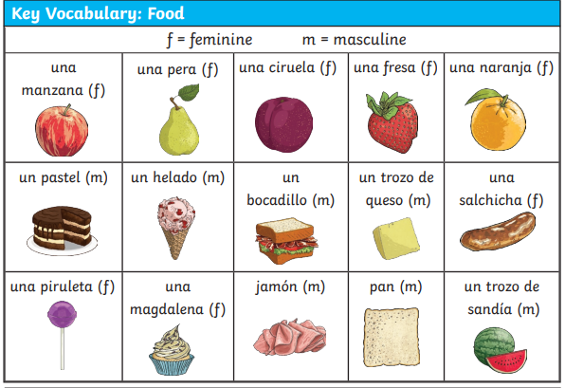
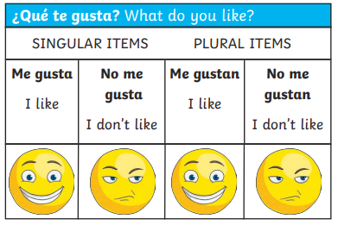
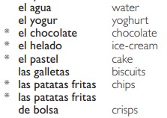


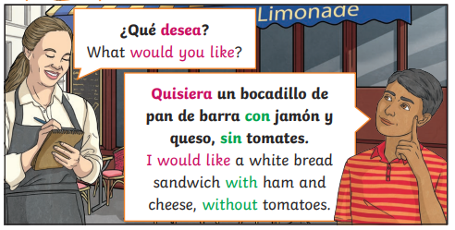
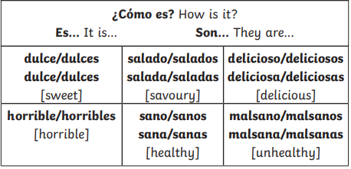
Lyppard Grange Primary School: Spanish Knowledge Organiser
Year 4: Unit 3 Summer Term | El Cafė (Food and Drink)
Additional Vocabulary
Additional Vocabulary – Conjunctions
con – with Sin – without Y – and Porque – because

Slide 2
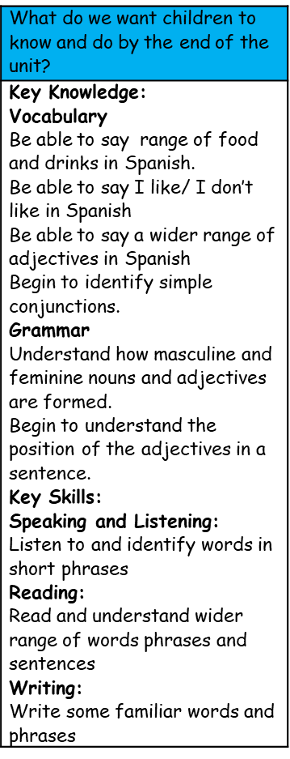
Lyppard Grange Primary School: Spanish Knowledge Organiser
Year 4 Unit 3: Summer Term | El Café (Food and Drink)
This follows on from: | This leads to:
Vocabulary: Daily Life Year 4 Spring Term – The Monster | Vocabulary: Daily Life Year 5 Summer Term – Places and Directions.
Grammar Year 4 unit 1: To know that you add /s/ to change a noun from singular to plural. | Grammar Year 5 - Begin to understand how the noun changes when it is written in the masculine and feminine form Year 5 - To apply taught plural rules.
Spanish Grammar – What you need to know!
In Spanish, adjectives are placed after the noun that they describe and they need to agree with it. If the noun is feminine, swap the -o with an -a at the end, e.g. un pastel delicioso [a delicious cake], una pera deliciosa [a delicious pear]. If the adjective finishes with an -e, it doesn’t change, e.g. una manzana horrible [a horrible apple]. If the noun is plural, remember to add an extra -s-, e.g. unas manzanas deliciosas [some delicious apples] *It is important to emphasise that in many languages the children will learn during their time in education the adjectives comes after the noun e.g French and Italian. It is also worth asking if children speak any other languages at home and comparing those languages.

Slide 3
Lyppard Grange Primary School: Spanish Knowledge Organiser
Year 4 Unit 3Summer Term | El Café (food and Drink)
How to progress through the unit. *Please ensure there is evidence of each stage in Pink Spanish Books. *When introducing new vocabulary print off a list and stick it into their books for future use.
Step 1: Introduce the children to key vocabulary – they need during the topic. This can be done through songs, games, word searches, listening games, labelling, ICT based activities, drawing and colouring (or anything else you think may make this interesting. This is where you can teach the grammar – focusing on the concepts of masculine and feminine nouns and how the final letter change between o and a based on the whether the noun is masculine or feminine. You can begin to introduce the position of adjectives in words. *Scheme Link: Y3 lesson 8 /Scheme Link: Y5 lesson 11- 15- you will find ideas and resources for this in the folders in PPA room or on staff share subject leader/Spanish/curriculum 2023-2024/scheme resources
Step 2: Children listen to and look at a range of conversations between water/waitress and customer and translate. This should include greetings, and orders – children also need to look out for conjunctions within the phrases/sentences. hey should be encouraged to look and listen for familiar words/phrases in order to get the meaning the whole sentence. Teachers will need to model simple techniques skills and they will need to give the children time to practice their skills using other sentences based on the model used in whole class teaching.
Step 3: Provide the children with opportunities to write using a combination of new material and known language in simple sentences (2-3 sentences) using the text translated in previous sessions as a model. Children create their own menus and role play scripts. Teachers will need to model writing 2-3 sentences as a model text (use-translated texts in previous sessions as a model). The children need to write their own text (2-3 sentences).. he support group would need a copy of the text in front of them to just change key points.
Step 4: Children take part in the café’. Children take part in role playing a café. They listen to each other and respond appropriately. Teacher’s to record these and upload as part of speaking and listening evidence collection.

