Slide 1
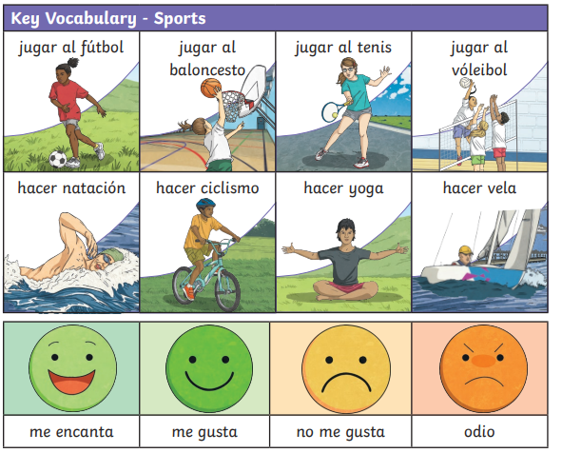
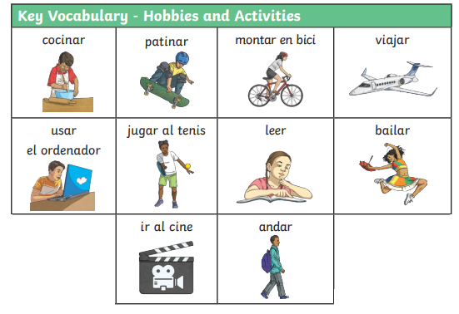
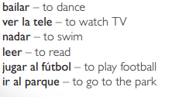
Lyppard Grange Primary School: Spanish Knowledge Organiser
Year 5 Unit 1:Autum Term | Mi passatiempoes (my Hobbies)
Additional Vocabulary
Additional Vocabulary – Conjunctions
Y – and Tambien – also Porque – because pero – but

Slide 2
Lyppard Grange Primary School: Spanish Knowledge Organiser
Year 5 Unit 1:Autumn Term | Mi passatiempoes (my Hobbies)
What do we want children to know and do by the end of the unit?
Key Knowledge: Vocabulary Be able to recall days of the week in Spanish Be able to name a range of hobbies and activities in Spanish. Be able to express likes and dislikes in Spanish Grammar: To use simple action verbs in the I form ( to play, to do and to go). To use the conjunction ‘and’ in written sentences. Key Skills: Speaking and Listening: Pick out some detail from short spoken passages Reading: To translate simple sentences using familiar words and using knowledge of English and other languages to work out unknown words. Writing: To write one or two sentences using action verbs and the conjunction ‘and’
This follows on from: | This leads to:
Vocabulry Year 3 Unit 2: Days of the week months of the year Year 4 Unit 3: The café | Vocabulary: Information about themselves Year 6 Autumn Term – All about me!
Grammar Year 4 Unit 3: Identify the conjunction /y/ as ‘and’ | Grammar Year 6 - To know and use simple verbs in the he/she and we form
Spanish Grammar – What you need to know!
Verbs! This is the first time children will come across Spanish verbs. In this unit they use them in the I form. Jugar al - I play Hacer - I do Ver -I watch Ir la/al - I go Tengo – Ihave Me gusta – I like | Conjunctions: Y – and Tambien – also Porque – because pero – but

Slide 3

Lyppard Grange Primary School: Spanish Knowledge Organiser
Year 5 Unit 1: Autumn Term | Mi passatiempoes (my Hobbies)
How to progress through the unit. *Please ensure there is evidence of each stage in Pink Spanish Books. *When introducing new vocabulary print off a list and stick it into their books for future use.
Step 1: Introduce the children to key vocabulary – they need during the topic. This can be done through songs, games, word searches, listening games, labelling, ICT based activities, drawing and colouring (or anything else you think may make this interesting. This is where you can teach the grammar – focusing on more complex sentence structures - The ending of the adjective is an o if it is a paired with a masculine noun, this changes to an a if it is paired with a feminine noun, if it ends in e it stays as an e. */Scheme Link: Y5 lessons 8-10. you will find ideas and resources for this in the folders in PPA room or on staff share subject leader/Spanish/curriculum 2023-2024/scheme resources
Step 2:Provide the children with opportunities to read and translate the new material longer phrases using more complex sentences with and, so because They should be encouraged to look for familiar words/phrases in order to translate the whole sentence. Teachers will need to model simple translation skills and they will need to give the children time to practice their skills using other sentences based on the model used in whole class teaching. Children listen to and look at a range of activity diaries and translate.
Step 3: Provide the children with opportunities to write using a combination of new material and known language in longer phrases using more complex sentences with and, so because Teachers will need to model writing 2-3 sentences as a model text (use-translated texts in previous sessions as a model). The children need to write their activity journal longer phrases using more complex sentences with and, so because. The support group would need a copy of the text in front of them to just change key points.
Step 4: Provide the children with opportunities to record their work, read their own work to others and to develop their speaking and listening skills by picking out key points when read aloud by a partner or listening to a recording. You can evidence this by getting the children to record what they hear.

