Slide 1
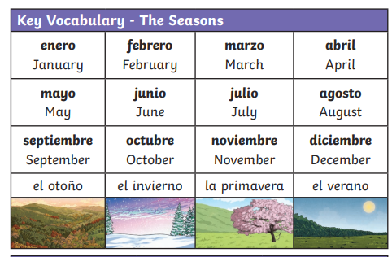
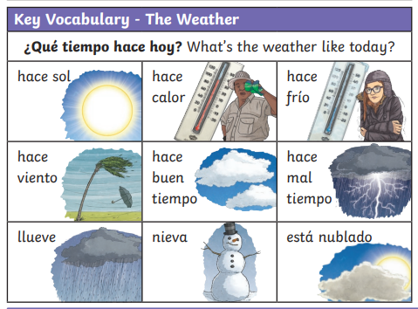
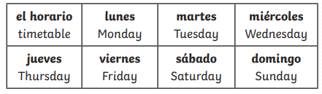
Lyppard Grange Primary School: Spanish Knowledge Organiser
Year 5 Unit 2: Spring Term | el tempio (The weather)
Additional Vocabulary
Hoy - Today Mañana – tomorrow Hoy hace buen tiempo – Today is good weather Mañana hace mal tiempo – Today is bad weather

Slide 2
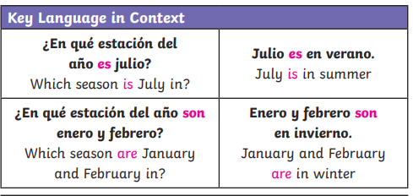
Lyppard Grange Primary School: Spanish Knowledge Organiser
Year 5 Unit 2: Spring Term | el tempio (The weather)
What do we want children to know and do by the end of the unit?
Key Knowledge: Vocabulary Be able to say the date in Spanish Be able to say what the weather is like in Spanish . Grammar To recognise the conjunctions but, also. Key Skills: Speaking and Listening: Make a short presentation using a given model. Reading: To translate simple sentences using familiar words and using context to work out unknown words. Writing: Write few sentences using a model
This follows on from: | This leads to:
Vocabulary: The World Around them Year 3 Unit 2 – Days of the week, months of the year. | Vocabulary: The World Around them Year 3 Summer Term – My holidays
Grammar Year 5 unit 1: To use the conjunction ‘and’ in written sentences. | Grammar Year 6 - To create grammatically correct sentences using adjectives, nouns, plurals and conjunctions.
Additional Vocabulary – Conjunctions
Y – and Tambien – also Porque – because pero – but

Slide 3
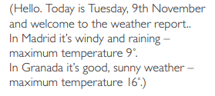
Lyppard Grange Primary School: Spanish Knowledge Organiser
Year 5 Unit 2: Spring Term | el tempio (The weather)
How to progress through the unit. *Please ensure there is evidence of each stage in Pink Spanish Books. *When introducing new vocabulary print off a list and stick it into their books for future use.
Step 1: Introduce the children to key vocabulary – they need during the topic. This can be done through songs, games, word searches, listening games, labelling, ICT based activities, drawing and colouring (or anything else you think may make this interesting. This is where you can teach the grammar – focusing on more complex sentence structures - The ending of the adjective is an o if it is a paired with a masculine noun, this changes to an a if it is paired with a feminine noun, if it ends in e it stays as an e. */Scheme Link: Y5 lessons 16-18 you will find ideas and resources for this in the folders in PPA room or on staff share subject leader/Spanish/curriculum 2023-2024/scheme resources
Step 2:Provide the children with opportunities to read and translate the new material longer phrases using more complex sentences with and, so because They should be encouraged to look for familiar words/phrases in order to translate the whole sentence. Teachers will need model simple translation skills and they will need to give the children time to practice their skills using other sentences based on the model used in whole class teaching. This should be a paragraph of a weather report. They could be provided with an Englsih copy and be required to translate into Spanish. It should include all of the attached information.
Step 3: Provide the children with opportunities to write using a combination of new material and known language in longer phrases using more complex sentences with and, so because Teachers will need to model writing 2-3 sentences as a model text (use-translated texts in previous sessions as a model). The support group would need a copy of the text in front of them to just change key points. Children should write a weather forecast. (Ensure conjunctions are used in the example text)
Step 4: Provide the children with opportunities to role play a weather forecast. This can be recorded as if a TV forecast and evidence uploaded into the evidence file on staff share. A partner can have a list of key questions they need to find the answer to during the presentation.

