Slide 1
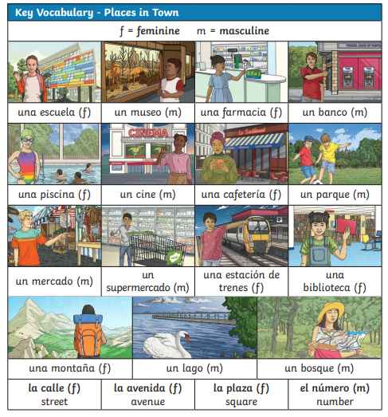
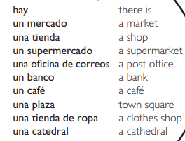


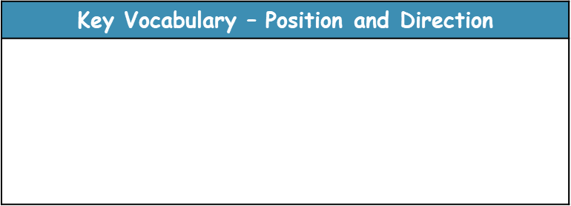
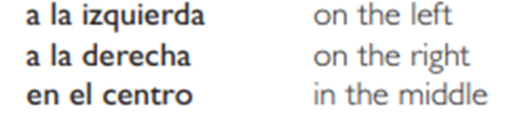
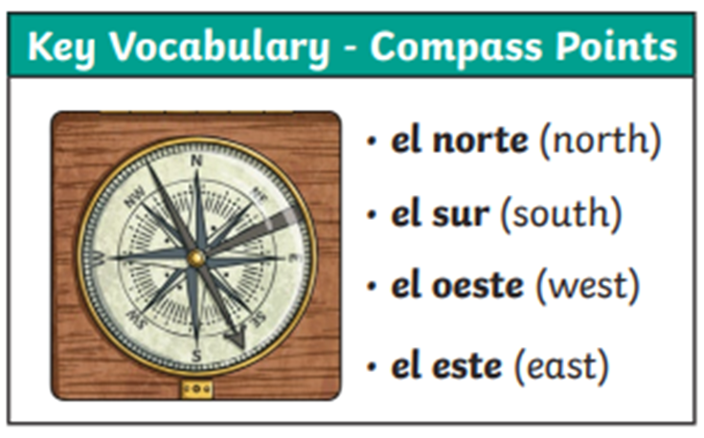
Lyppard Grange Primary School: Spanish Knowledge Organiser
Year 5 Unit 3: SummerTerm | Lugaras y direcciones (Places and Directions)
Key Vocabulary
Additional Vocabulary - adjectives
Additional Vocabulary – Conjunctions
Y – and Tambien – also Porque – because pero – but

Slide 2
Lyppard Grange Primary School: Spanish Knowledge Organiser
Year 5: Autumn Term | Mi passatiempoes (my Hobbies)
Lyppard Grange Primary School: Spanish Knowledge Organiser
Year 5 Unit 3: Summer Term | Lugaras y direcciones (Places and Directions)
What do we want children to know and do by the end of the unit?
Key Knowledge: Vocabulary Say what buildings can be found on the high street and use adjectives to describe them Grammar: To describe how the noun changes when it is written in the masculine and feminine form To describe how the adjective changes when it is written in the masculine and feminine form Key Skills: Speaking and Listening: Listen to and understand the main points from short spoken passage. Reading: To translate a paragraph using context to work out unknown words. Writing: Write a paragraph using a model.
This follows on from: | This leads to:
Vocabulary: Daily Life Year 4 Unit 3 – The Café | Vocabulary: The World Around them Year 6 Spring Term – My dream house.
Grammar Year 4 Unit 2: To know that in Spanish the adjective comes after the noun in a sentence and that is different to English. | Grammar Year 6 - To create grammatically correct sentences using adjectives, nouns, plurals and conjunctions.
Spanish Grammar – What you need to know!
In Spanish, adjectives are placed after the noun that they describe and they need to agree with it. If the noun is feminine, swap the -o with an -a at the end, of the adjective e.g. una tienda magnifica [a magnificent shop], If the noun is masculine keep the -o at the end, of the adjective e.g. un banco tranquillo [a quiet bank]. If the adjective finishes with an -e, it doesn’t change, e.g. una tienda grande [a big shop]. *It is important to emphasise that in many languages the children will learn during their time in education the adjectives comes after the noun e.g French and Italian. It is also worth asking if children speak any other languages at home and comparing those languages. | Plurals! Plurals in Spanish are usually formed by adding –s- Tengo dos hermanos – I have two brothers. However, if the word ends in a consonant you add –es- Quisiera dos pasteles – I would like two cakes.

Slide 3
Lyppard Grange Primary School: Spanish Knowledge Organiser
Year 5: Autumn Term | Mi passatiempoes (my Hobbies)
Lyppard Grange Primary School: Spanish Knowledge Organiser
Year 5 Unit 3: Summer Term | Lugaras y direcciones (Places and Directions)
How to progress through the unit. *Please ensure there is evidence of each stage in Pink Spanish Books. *When introducing new vocabulary print off a list and stick it into their books for future use.
Step 1: Introduce the children to key vocabulary – they need during the topic. This can be done through songs, games, word searches, listening games, labelling, ICT based activities, drawing and colouring (or anything else you think may make this interesting. This is where you can teach the grammar – focusing on more complex sentence structures - The ending of the adjective is an o if it is a paired with a masculine noun, this changes to an a if it is paired with a feminine noun, if it ends in e it stays as an e. */Scheme Link: Y5 lessons 1-2 you will find ideas and resources for this in the folders in PPA room or on staff share subject leader/Spanish/curriculum scheme resources.
Step 2:Provide the children with opportunities to read and translate the new material in longer sentences using more complex sentences with and, so because They should be encouraged to look for familiar words/phrases in order to translate the whole sentence. Teachers will need model simple translation skills and they will need to give the children time to practice their skills using other sentences based on the model used in whole class teaching. This should be a paragraph describing a high street. */Scheme Link: Y5 lesson 4 you will find ideas and resources to support reading and writing in this unit in the folders in PPA room or on staff share subject leader/Spanish/curriculum scheme resources.
. Step 3: Provide the children with opportunities to write using a combination of new material and known language in longer phrases using more complex sentences with and, so because Teachers will need to model writing paragraph as a model text (use-translated texts in previous sessions as a model). The support group would need a copy of the text in front of them to just change key points. Children should write a paragraph about their high street. */Scheme Link: Y5 lessons 4 you will find ideas and resources to support reading and writing in this unit in the folders in PPA room or on staff share subject leader/Spanish/curriculum scheme resources.
Step 4:. Speaking and Listening: Children should engage in conversations – asking for directions to different places on the maps they have created */Scheme Link: Y5 lessons 4 you will find ideas and resources to support reading and writing in this unit in the folders in PPA room or on staff share subject leader/Spanish/curriculum scheme resources

