Slide 1
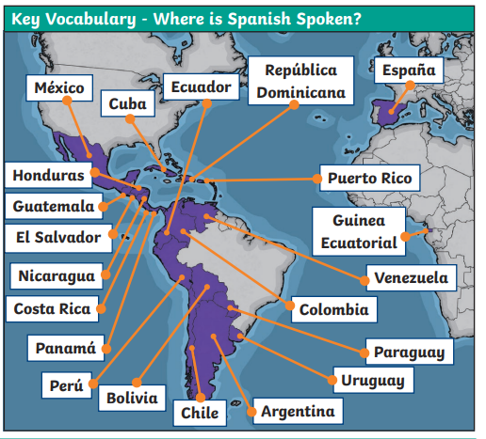

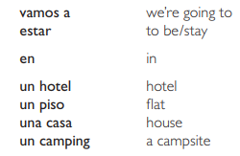


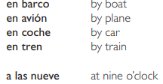

Lyppard Grange Primary School: Spanish Knowledge Organiser
Year 6 Unit 3: Summer Term | Mis vacaciones (My Holiday)
Key Vocabulary – Step 1
Key Vocabulary – Step 2 (Accommodation)
Key Vocabulary – Step 3 and 4 (Travel and Food)
Key Vocabulary – Step 5 (Places of interest)
Also see Y5 summer term for key vocabulary relating to places of interest.
Additional Vocabulary – Conjunctions
Y – and Tambien – also Porque – because pero – but Luego – then/next

Slide 2
Lyppard Grange Primary School: Spanish Knowledge Organiser
Year 5: Autumn Term | Mi passatiempoes (my Hobbies)
Lyppard Grange Primary School: Spanish Knowledge Organiser
Year 6 Unit 3: Summer Term | Mis vacaciones (My Holiday)
What do we want children to know and do by the end of the unit?
Key Knowledge: Vocabulary Be able to identify and name Spanish speaking countries across the world. To be able to name different accommodation types, methods of travel food and activities Grammar: To know simple verbs and use them in the we form. Key Skills: Speaking and Listening To give a presentation in a clear audible voice. Reading: To use a variety of skills to work out the meaning. Writing: To apply taught grammatical structures (conjunctions, plurals nouns and adjectives) to longer pieces of writing. .
This follows on from: | This leads to:
Vocabulary: The World Around Them Year 5 Spring Term – The weather | Vocabulary: The World Around Them Year 7 curriculum outcomes.
Grammar Year 4 Unit 3: Write a simple sentence changing a singular noun to a plural by adding /s/. Year 5 Unit 2: To write sentences with the correct noun/adjective agreement depending on whether the noun is masculine or feminine. Year 6 Unit 1: To identify simple verbs and use them in the he/she/they forms. (to have, to live, to like, to play) Year 6 Unit 1: To write sentences using conjunctions (and, but also) | Grammar Year 7 curriculum outcomes.
Spanish Grammar – What you need to know!
Verbs! In this unit the children will need to use the verb – we are going to… Vamos a …. And then add on the verb required. Vamos a ir – We are going to go Vamos a estar – We are going to stay Vamos a comer - We are going to eat Vamos a visitar – We are going to visit Vamos a viajar – We are going to travel ….. by….. Vamos a viajar en barco – We are going to travel by boat

Slide 3
Lyppard Grange Primary School: Spanish Knowledge Organiser
Year 5: Autumn Term | Mi passatiempoes (my Hobbies)
Lyppard Grange Primary School: Spanish Knowledge Organiser
Year 6 Unit 3: Summer Term | Mis vacaciones (My Holiday)
How to progress through the unit. *Please ensure there is evidence of each stage in Pink Spanish Books. *When introducing new vocabulary print off a list and stick it into their books for future use.
Step 1: Children will undertake project work: Planning a holiday to a Spanish speaking country. They may work either individually or in pairs, but all children must present a portfolio of work at the end of the project.. During the project they will make use of the internet to undertake research. Sometimes they will read information in English, sometimes in Spanish. Children will learn phrases/vocabulary in Spanish during the lessons, which will enable them to note key details about their holiday plans in Spanish in their portfolios/files. At the end of this term they will produce a presentation using simple sentences in Spanish about the country visited which may include: − weather and temperature − accommodation /Scheme Link: Y6 lesson 14. You will find a teaching sequences and resources for this in the folders in PPA room or on staff share subject leader/Spanish/scheme resources. There is also a flipchat page to support this unit in this folder.
Step 2,3 ,4 and 5: Children learn key vocabulary for different accommodation, travel, food and activities and read and translate a range of materials. They will then write their own paragraphs at each stage. Children need to read and write in paragraphs using longer phrase and more complex sentences. Scheme Link: Y6 lesson 15, 16, 17 and 18 You will find a teaching sequences and resources for each stage in the folders in PPA room or on staff share subject leader/Spanish/scheme resources. There is also a flipchat page to support this unit in this folder. N.B children must read, translate and write at each stage,
Step 6:Children will prepare a presentation about an aspect/aspects of culture from the country they have chosen to visit. The presentation could involve the following: • individual presentations • presentations from children working in pairs • presentations from small groups of children, who have all chosen the same country The presentation should include elements in Spanish (using simple sentences practised during the last few lessons) or individual words – e.g. to introduce different food items. The children may want to give more detailed information in English about something that particularly interests them. The presentation could include: • songs, dances, music from the country • a multi-media presentation or ppt using simple sentences and visual images to present information about: - food - climate - places of interest • a presentation on one cultural aspect of the country e.g. sport, festival(s)P. Scheme Link: Y6 lesson 18 and 19. You will find a teaching sequences and resources for each stage in the folders in PPA room or on staff share subject leader/Spanish/scheme resources. There is also a flipchat page to support this unit in this folder
Step : Provide the children with opportunities to present their work to others and to develop their speaking and listening skills by picking out key points when read aloud by a partner or listening to a recording. You can evidence this by getting the children to record what they hear.

