Slide 1







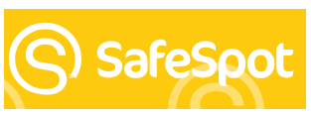






General Mental Health and Wellbeing Resources
YourSpace Children and Young People's Hubs

Slide 2








Illness and Bereavement Resources
Bereavement support | Worcestershire County Council
How to talk to your child about grief | Barnardo's
Trauma Resources
Eating Disorder Resources

