Slide 1

Year 2
Parent Workshop
Thursday 17th September 2026

Slide 2
Writing
Year 2
Parent Workshop

Slide 3

Writing in Year 2 – Talk for Writing
At Lyppard Grange Primary school we teach writing through our themes and link our writing to quality texts and books.
  Our current theme is A Mystery in Fairytale Land. We have been reading a wide range of fairy tales and alternative versions of fairy tales too.
We use the T4W (Talk for Writing) approach to teaching writing, across the school.
  If your children were with us in EYFS and Year 1, then they are already familiar with this approach
  T4W is an approach to teaching writing that has been developed by the literacy specialist Pie Corbett.
  It splits writing into three-stages:
    Imitation – where children learn and unpick the model text
    Innovation – where children use these ideas and structures from the model text to change their writing and create new versions
    Invention – where children independently create their own texts, based on the knowledge they have learnt

Slide 4
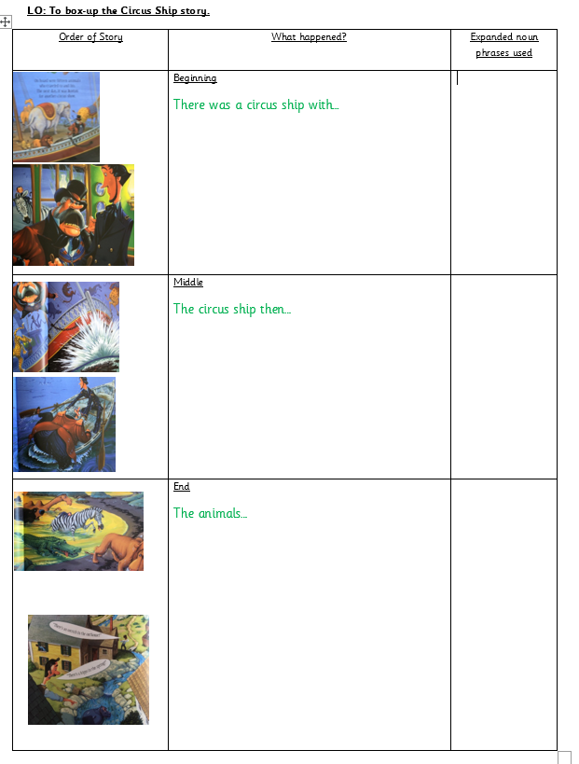
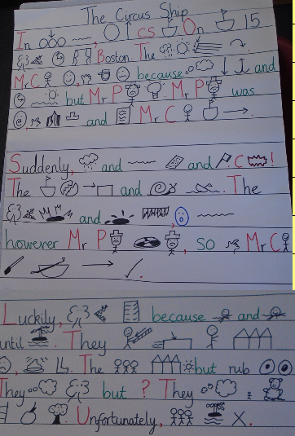
Talk for Writing examples
  Text mapping with actions and boxing up
  Boxing up
  (Planning)
  Text maps

Slide 5
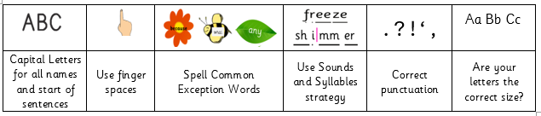
Writing in Year 2
We teach writing as a whole class
  The same as all other subjects in Year 2
Children all work towards the same target, as identified from the National Curriculum, but sometimes children are given specific tailored targets during our writing lessons. They are also supported with different scaffolds to allow them to achieve their potential.
All year groups now have non-negotiables, children need to ensure that any piece of writing has these features in. By the end of Year 2, children should be confident when self-assessing and editing their writing against the non-negotiables and other features.

Slide 6
Key points
Word mats – to help children spell common exception words
Phonics strips
Children have time to complete feedback given
Microphones can be used to help children orally rehearse their writing

Slide 7
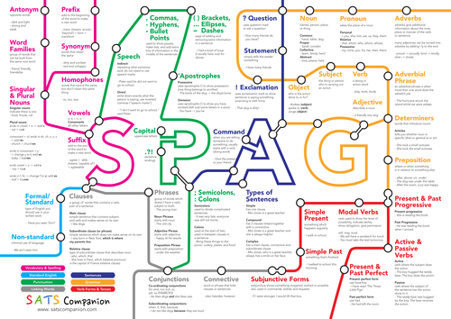
SPaG
Spelling Punctuation and Grammar
We are ‘frontloading’ our grammar to the beginning of the year for each year group. This should be taught by the end of the Autumn term.
KS2 follow ‘Sounds and Syllables’ which is a scheme for spelling. Our children will be working towards this, with elements of ‘Sounds and Syllables’ but will primarily be focussing on re-capping their phonics and learning new alternative graphemes until October half term.
    This method is a way of using our ‘spelling voice’, counting the syllables in words, and writing the sounds down.
    We do not have spelling tests at Lyppard Grange Primary.

Slide 8
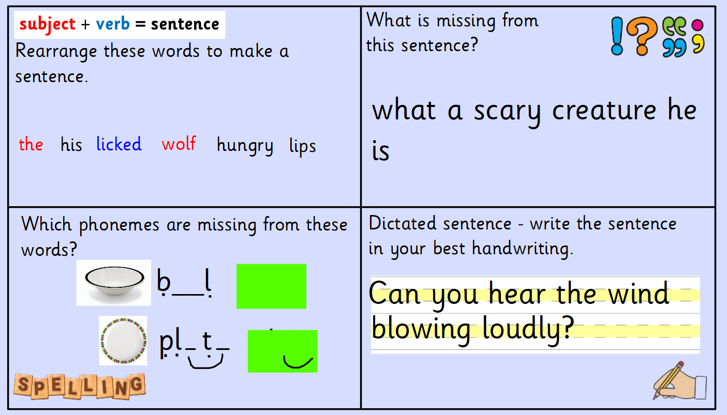
Writing Magic
We are teaching SPaG knowledge through our new ‘Writing Magic’ lessons.
This is being used throughout the school and matches the SPaG being taught in each year group
This is a daily 15-minute lesson

Slide 9
Pen pals
We have adopted a new handwriting scheme, and we will be teaching children to join their handwriting

Slide 10
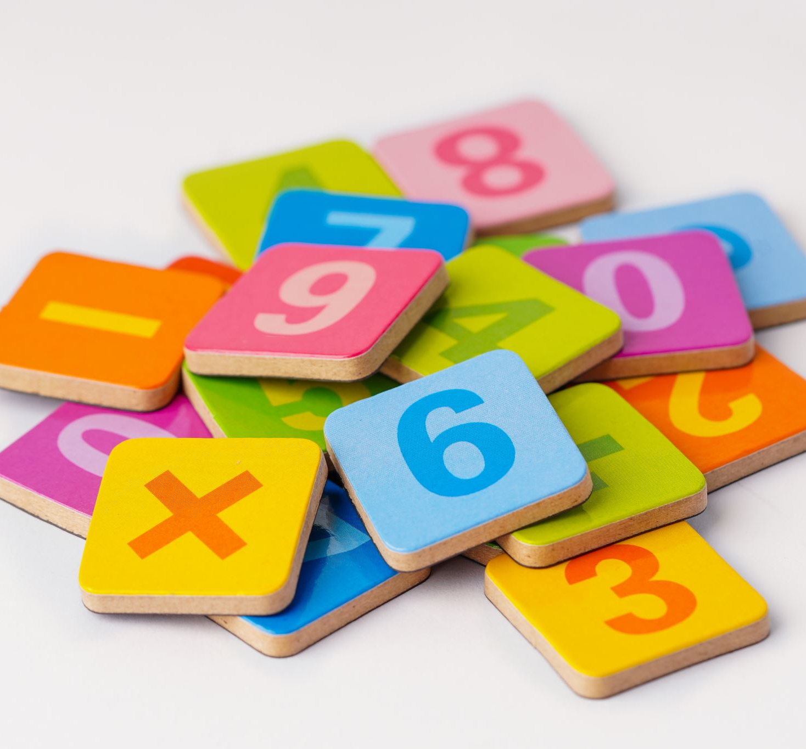
Maths

Slide 11

Children must feel positive about maths to be numerate.

Slide 12
Mastery Curriculum in Mathematics
At Lyppard Grange, we use the glow project approach to maths. The children are encouraged to build up skills through whole class interactive teaching using concrete resources, where the focus is on all working together on the same content at the same time.

Slide 13
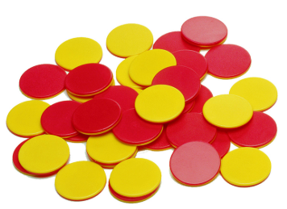
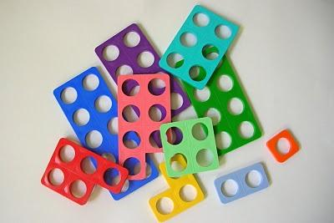
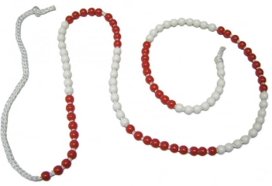
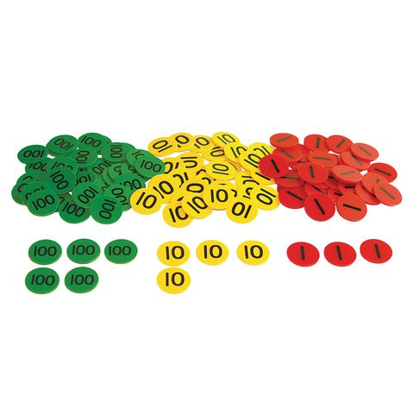
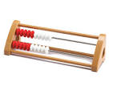
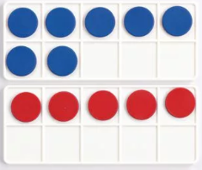
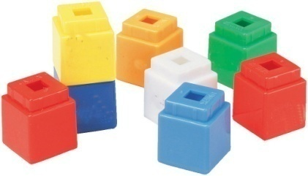
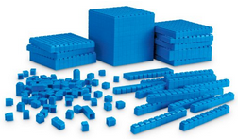
Concrete Resources
Notes:
Doing stage- We try to encourage children to use concrete resources as much as possible to support their understanding of number. Maths becomes more tangible when chn are able to physically handle objects themselves. For example, this term we are working on place value. So we have provided chn with opportunities to build numbers using various resources- talking about the value of the digits- the number of tens, how many ones etc. Helps chn in understanding abstract concepts like fractions.

Slide 14
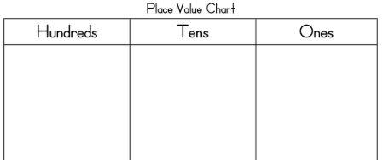
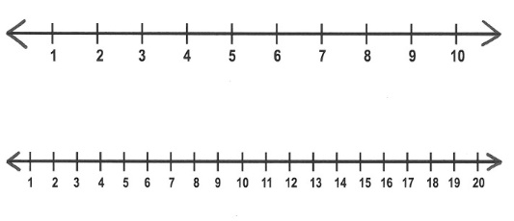


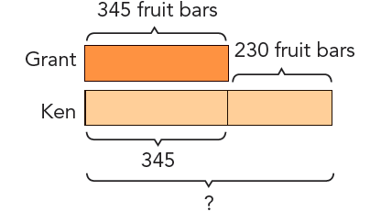
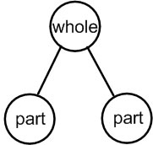
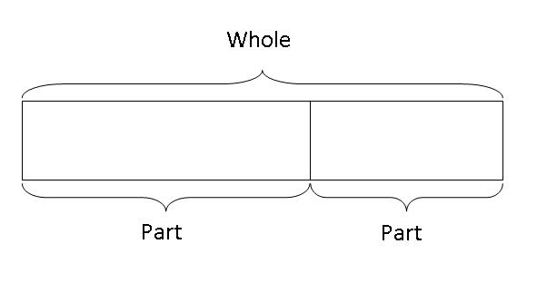
Pictorial representations
Notes:
Seeing stage- Essentially using drawings to help them solve problems. Visual representations of the concrete objects are used to solve problems. They build a connection between physical and abstract.
Alongside the use of concrete resources, we encourage chn to use pictorial representations such as whole part models, bar models and place value charts.

Slide 15
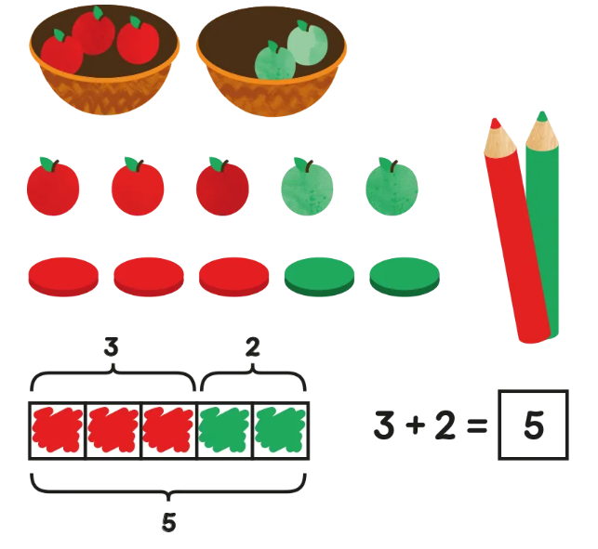
Abstract representations
Notes:
Moving to using mathematical numbers and symbols.

Slide 16
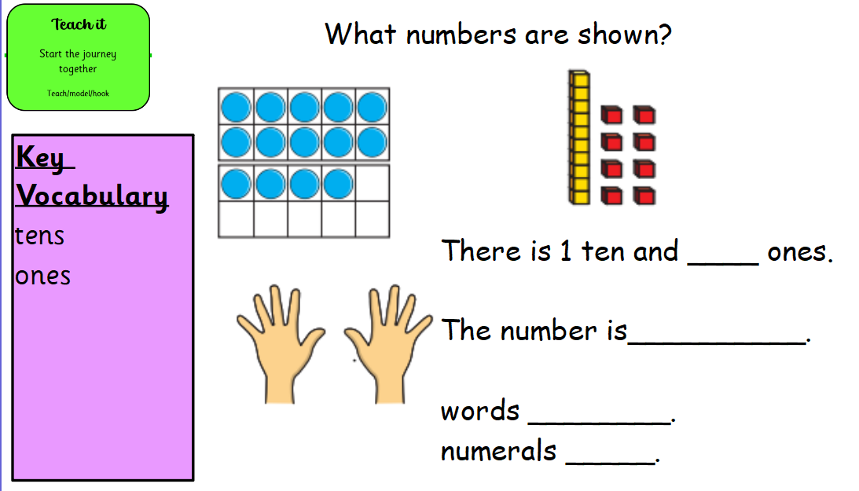
Lesson format – teach it- teacher models
Notes:
Key vocabulary- chn encouraged to use correct vocabulary when talking about maths.
Sentence stems- choral rehearsal of sentence stems.

Slide 17
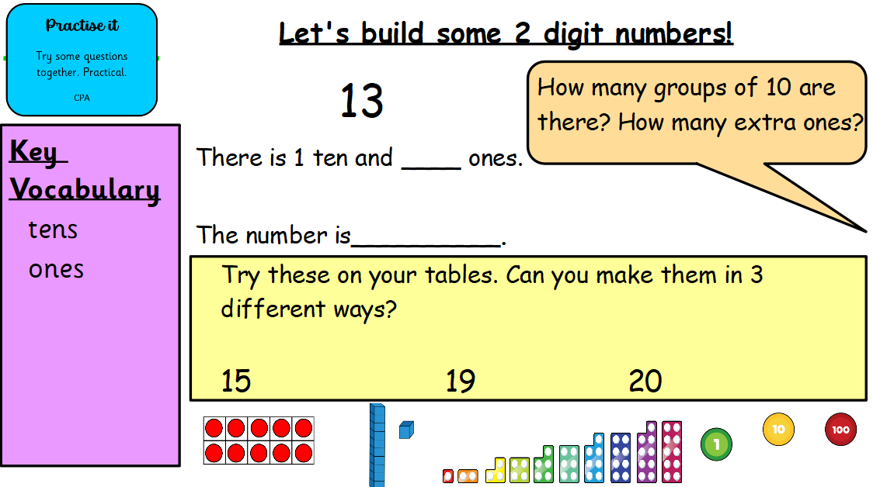
Practise it- go through questions together using practical resources.

Slide 18
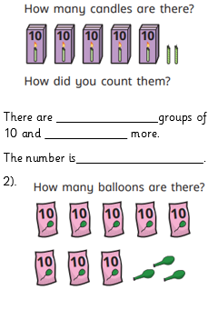
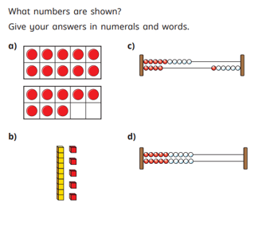
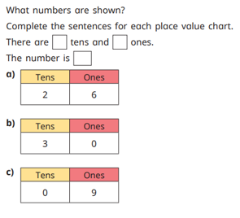
Lesson format- do it
Fluency based tasks to rehearse and secure. Small task in books.

Slide 19
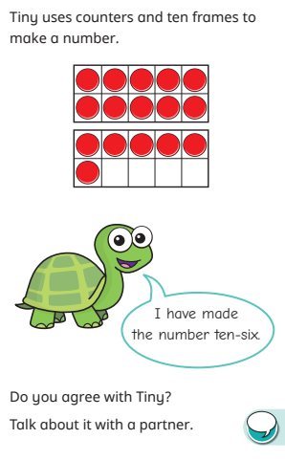
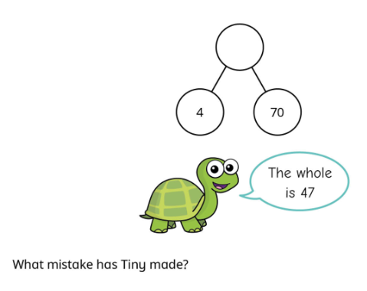
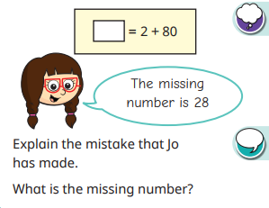
Twist it task- focus on misconceptions and opportunities to reason.
Notes:
What mistake have they made? True or false? Do you agree? Why? – we encourage chn to begin to apply their maths knowledge, proving their answers.

Slide 20
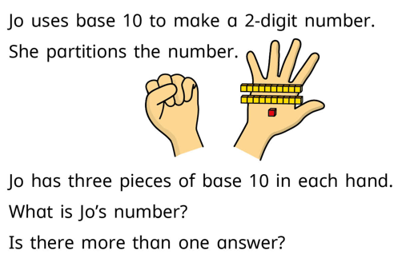
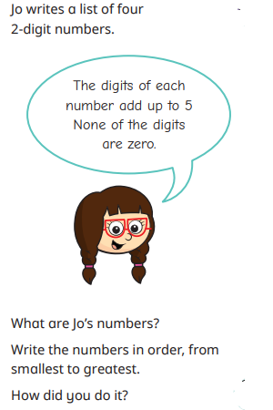
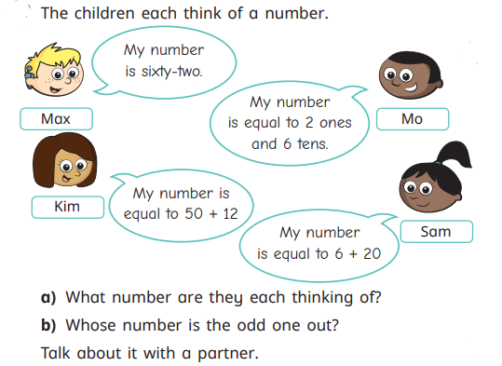
Deepen it task- apply learning to solve problems.
Notes:
Problem solving tasks. Allow a deeper level of thinking.

Slide 21
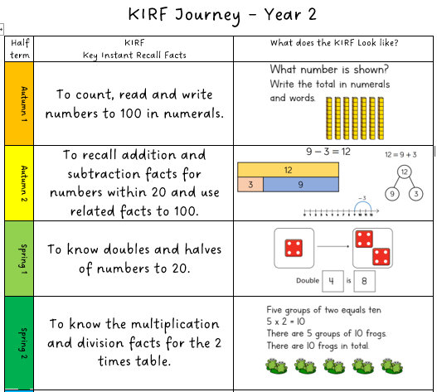
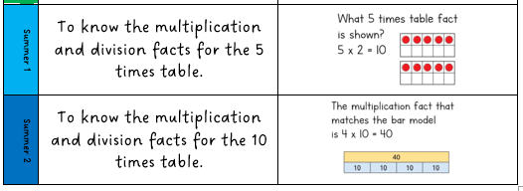
KIRFS-
Notes:
KIRFs- are our key instant recall facts. There will be different KIRF each term which we will be working on in school so the children become really confident with them. Some of the homework may be based around the KIRF too. We will notify you on the website of each new KIRF and add a parent guide with some helpful tips and ideas for practising them at home.

Slide 22
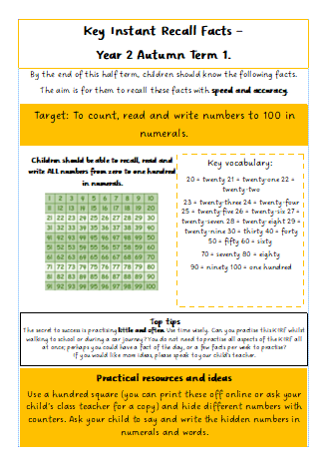
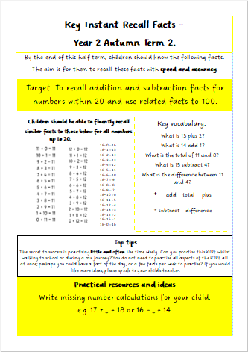
Parent guides

Slide 23
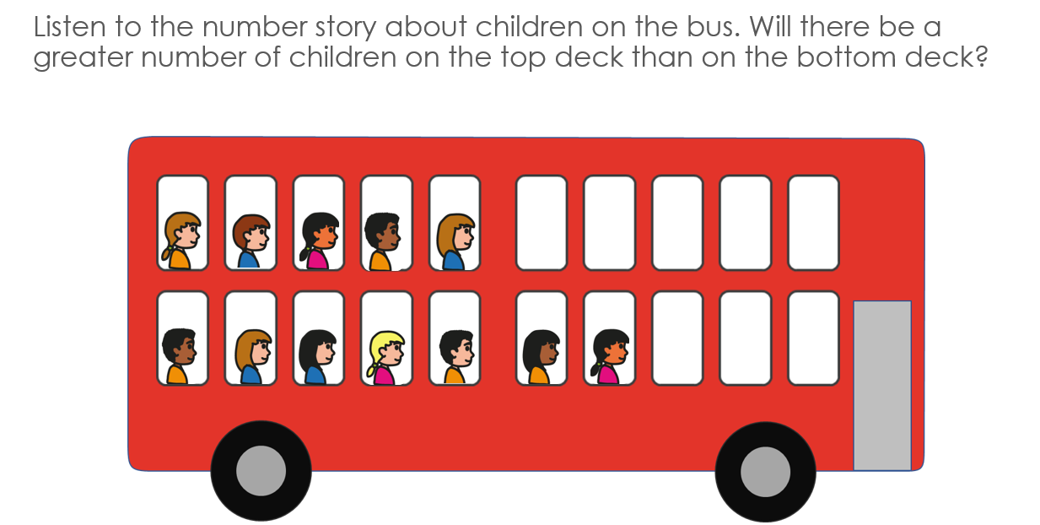
Mastering Number
This will progress into ‘Number Magic’ lessons from January.
Mastering number is about subitising (recognising a number without counting) and using this skill to solve problems.
rekenrek
Notes:
Problem solving tasks. Allow a deeper level of thinking.

Slide 24
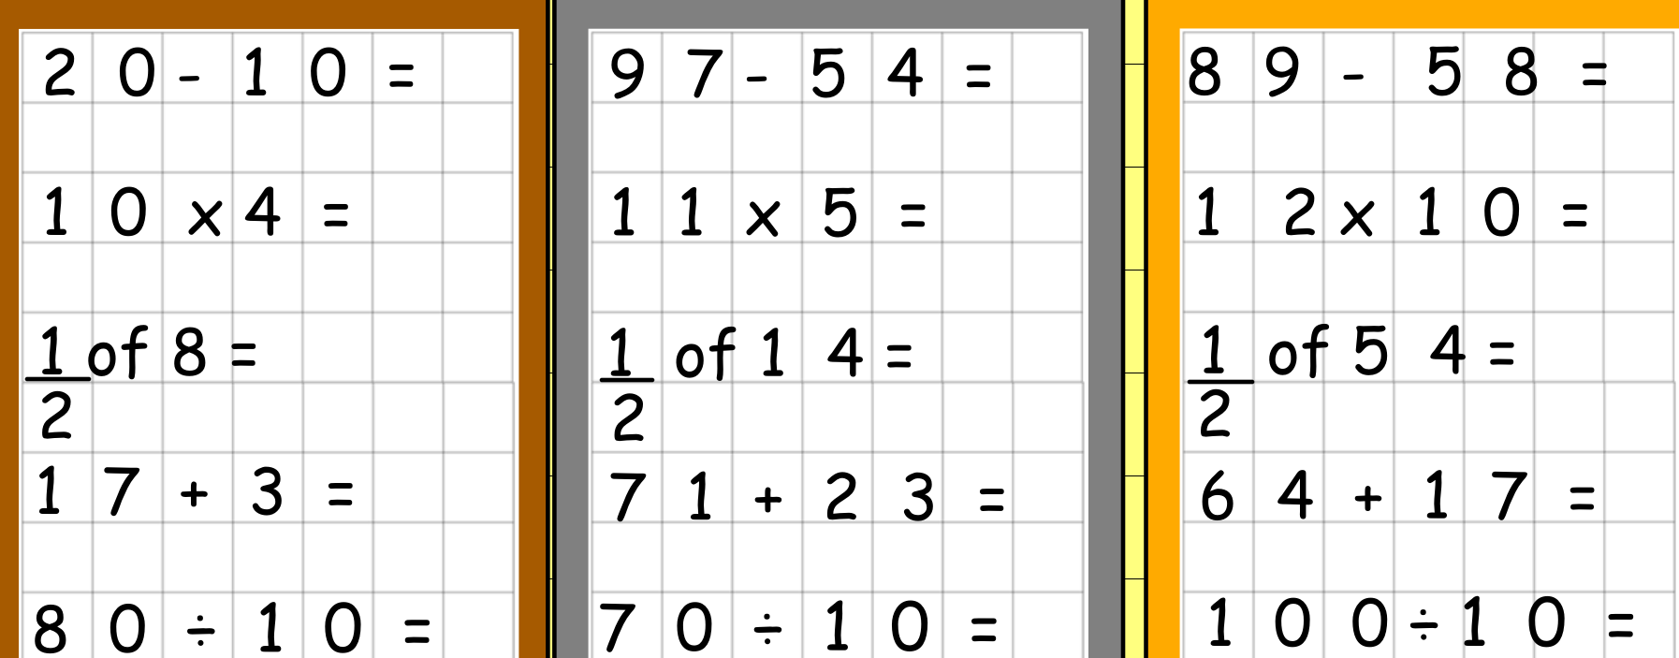
Number Magic
Number Magic - this starts with a five minute practise of that term’s ‘KIRF’.
Then children will have 5 questions to complete – there are three different levels: bronze, silver or gold
The lesson concludes with a re-cap of previous learning called a ‘Flashback 4’
Notes:
Problem solving tasks. Allow a deeper level of thinking.

Slide 25

- Number bonds to 10, 20 and 100
- Quick fire maths! (Such as addition and subtraction questions)
- Counting in 2s, 3s, 5s, and 10s – forwards and backwards
- 10, 2, 5 and 3 times tables
- TTRockstars (Beginning in January 2026)
How to help at home:

Slide 26
Maths Challenge
The Maths Challenge will take place weekly.
In year 2, we will start by covering number bonds to 10, 20 and 100. Followed by the 10x table, 2x table and 5x table.
Children need to score 20 to move onto the next challenge. A slip will be sent home explaining which challenge they are currently working on.
All children will begin on number bonds to 10.
We will also set times tables rockstars homework (from January). You will be invited to a workshop to find out more about this nearer the time.
Children will receive 2 tokens for completing their TTRS homework, another token if they get 95% accuracy or more and 4 tokens if they achieve 100% accuracy.
The more children can practise the better!
Notes:
Timestables need to begin to become embedded in Year 2. Knowing their tables makes maths so much easier. At end of Year 4, government expectation is all children know all tables to 12x so starting in Year 2 gives chn a much better chance of being secure by year 4.

Slide 27
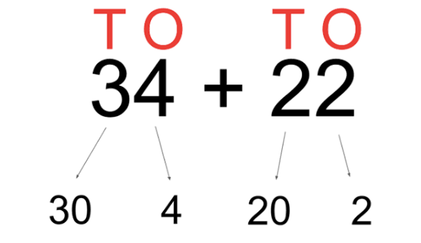
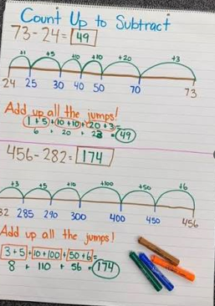
Written methods for Year 2

Slide 28
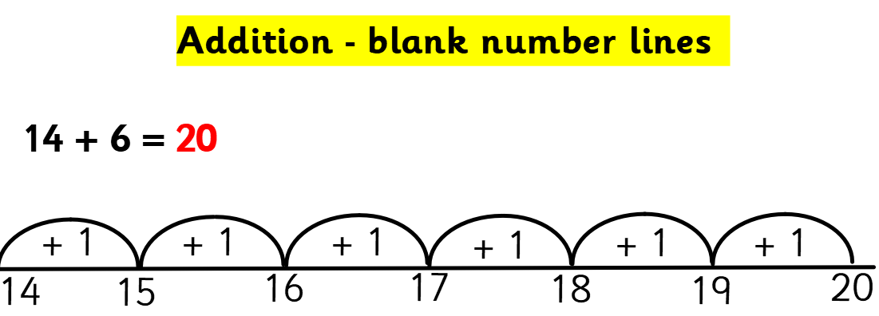

Slide 29
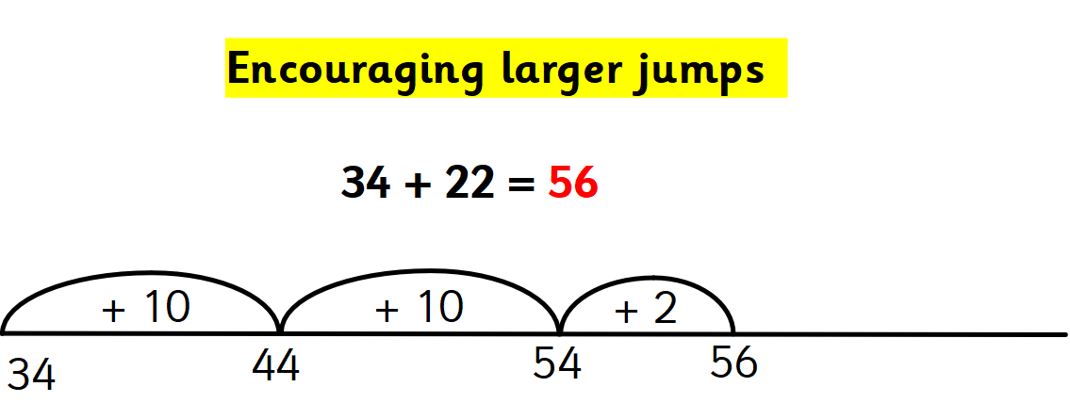

Slide 30
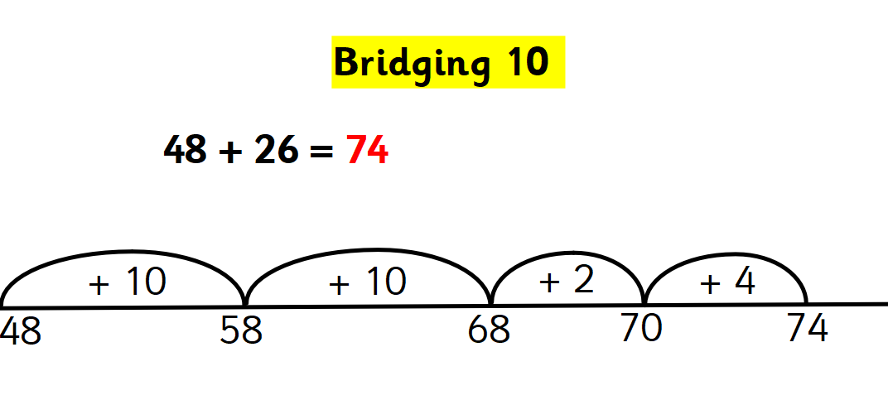
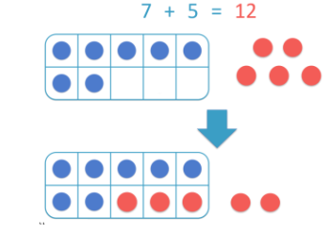
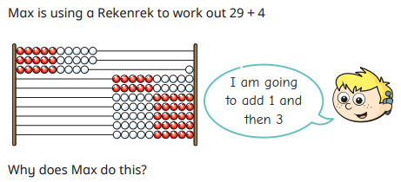

Slide 31
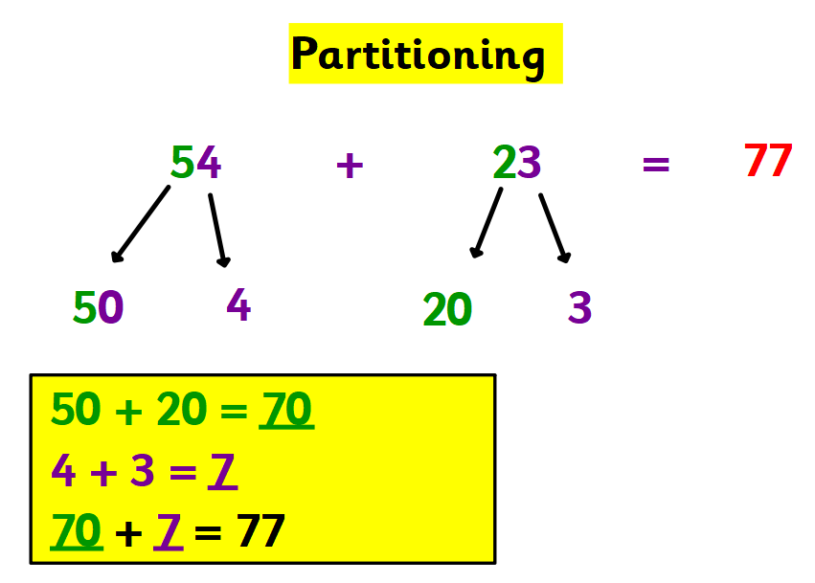
Notes:
Using base ten is a useful resource here to help them build the numbers and work out how many tens, how many ones? How many are there altogether?

Slide 32
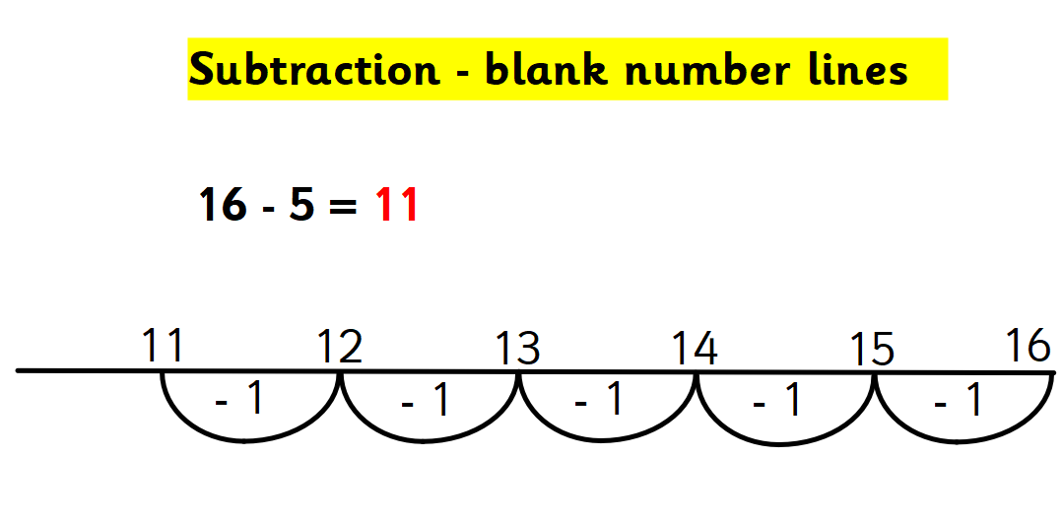
Notes:
Using base ten is a useful resource here to help them build the numbers and work out how many tens, how many ones? How many are there altogether?

Slide 33
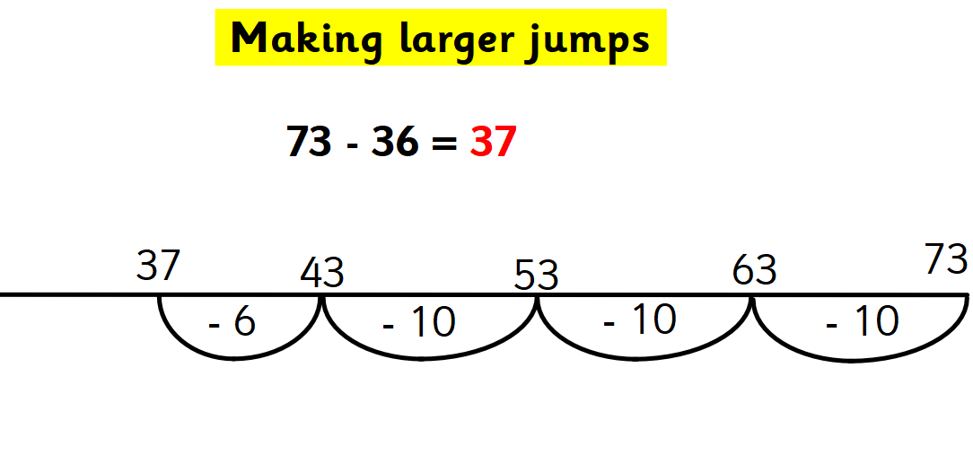
Notes:
Subtracting tens and ones.

Slide 34
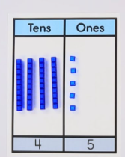
Subtraction (exchanging)- using base ten
45 – 27 =
Notes:
We use base ten to aid their understanding when exchanging. We can’t take 7 ones away, there aren’t enough so we need to exchange a ten for ten ones. Then subtract the ones, then the tens.

Slide 35
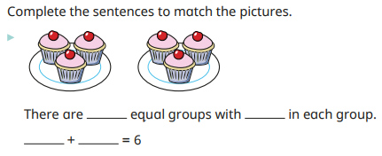
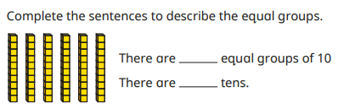
Multiplication
We introduce multiplication by talking about equal groups so that
children begin to make the connection between repeated addition and multiplication.
Notes:
We use base ten to aid their understanding when exchanging. We can’t take 7 ones away, there aren’t enough so we need to exchange a ten for ten ones. Then subtract the ones, then the tens.

Slide 36

Notes:
We use the language of ‘lots of’ or ‘groups of’ alongside the multiplication symbol. E.g. 4 groups of 5 or 4 lots of 5- which is same as 4 x 5.

Slide 37

Notes:
We use the language of ‘lots of’ or ‘groups of’ alongside the multiplication symbol. E.g. 4 groups of 5 or 4 lots of 5- which is same as 4 x 5.

Slide 38


Slide 39


Division
We introduce division by applying their knowledge of equal groups and sharing.
For example, take 15 counters and share them into groups of 3.
We encourage the use of both concrete and pictorial resources to support their understanding.

Slide 40


Slide 41

Notes:
Share out into equal groups by using crosses.

Slide 42

Reading

Slide 43

Reading in Year 2
At Lyppard Grange Primary School in Year 2 the children participate in whole class reading.
In WCR- the children read individually and as a class.
Additionally- Children are heard by an adult at least once a fortnight.
Children should be listened to at home every day for approximately 10 minutes – this is their homework.
Please ensure journals are written in and in school every day.
If your child finishes their book, this needs to be stated before it will be changed.
Notes:
Journals must be clearly dated and signed by someone at home for books to be changed.

Slide 44

Book Bands
We are aiming for children to be on ‘White’ level books by the end of Year 2 for them to be at the expected standard.
If children reach the end of the reading scheme they move onto ‘Reading Explorer’ books which are more challenging chapter books.
Notes:
Journals must be clearly dated and signed by someone at home for books to be changed.

Slide 45
What is Whole Class Reading?
It is used throughout the school from Y2-Y6
It supports children’s reading as well as their reading comprehension.
We listen to children’s responses; this supports our evidence when assessing your child’s comprehension.
Notes:
Over the last half term we have shown the children how we expect them to join in with the WCR sessions.
We have also alternated it with Group reading to maintain individual reading, encouraging responses from the children in a small group environment before moving onto whole class sessions.
So what does WCR look like?

Slide 46

Reading for fluency
Class Teacher reads
Modelled intonation, expression.
Introduce our WOW Words
Notes:
CT reads the whole text to model expression and change of voice…
Children are encouraged to listen to the text and ask questions if they have any.
The session encourages the children to hear the way the text should be read and gain an understanding of the story/ information book before delving deeper into the text in the following lessons.
WOWords are chosen to widen children’s vocabulary. By explaining the meanings it gives them the opportunity to use them in their writing. The words are displayed for the rest of the week.

Slide 47

Line by line
Questions asked by Class Teacher
The next day at the crack of dawn,
a ship was at the pier
and up the lane marched Mr Paine,
whose voice was loud and clear.
“I am the circus owner
My ship sank in the murk.
I’ve come to find my animals
And put them back to work”.
Notes:
As line by line is carried out the teacher will ask the children questions for example;
What effect does the word ‘march’ have on you as a reader?
Which word class does ‘march’ belong to? How do you know?
Does the owner show that he has missed his animals?
Meanwhile, TA will record children’s responses to aid teacher’s assessment of key objectives, address any misconceptions or gaps in children’s knowledge to be revisited in further sessions.

Slide 48

Leapfrog
The class are given examples that are linked to the task.
Whiteboard work with lots of discussion.
Support for the task the following day.
Notes:
Supports the children to know how to complete a reading task.
Allows children to complete the task with more independence because it has already been talked through the previous day.

Slide 49

Task
Activity for the children to show their understanding.
Notes:
This is put into their theme book and used to show the children’s understanding and aid the teacher in spotting any gaps to revisit in further sessions.

Slide 50


Phonics in Year 2
Continue to practise Year 1 phonemes.
Additional Year 2 graphemes.
‘Does it look right’ for home and school, this is vital in supporting your child when using new graphemes and improving their spelling.
phoneme – a sound
grapheme – group of letters that make up a sound
Notes:
Children practise previous phonemes with games and activities.
There are a few additional graphemes they still need to be taught in Year 2 before the children will move onto spelling patterns.
Does it look right is a method that should be used for both home and school. Here’s how it works….

Slide 51
Does it look right?
chair
air ear are
chair chear chare
Which one looks right?
It’s okay if they do not select the correct one at this stage, they will in time become more familiar. The more they read the more familiar they will be with the correct spelling of words.

Slide 52
SATs
In previous years, the government has required schools to complete statutory assessments in Year 2 during the month of May. These assessments were used alongside teacher judgement to formulate children’s end of year assessment.
The Year 2 SATs are now optional and we choose not to administer them at Lyppard Grange.
However, at the end of the Autumn, Spring and Summer term children completed Testbase Standardised Tests in reading and maths. The marks from these are converted into scaled scores which allow us to see whether the children are working towards, at or above age related expectations and will be used to help inform our teacher judgements at the end of the year.
Notes:
The tests are informal.
Children complete them in small groups, in their classroom with their regular class teacher.
The tests are not timed.
Nobody needs to worry about them.

Slide 53


Reading test 1

Slide 54


Reading test 2

Slide 55



Maths - arithmetic

Slide 56




Maths - reasoning

Slide 57

RSE
(Relationships and Sex Education)
RSE will be taught during the Summer Term (Jigsaw scheme).
In Year 2 children will learn that;
life cycles exist in nature.
To know how their bodies have changed from when they were a baby and that they will continue to change as they age.
To know the physical differences between male and female bodies.
To know the correct names for private body parts.
To know who to ask for help if they are worried or frightened.
To be able to confidently ask someone to stop if they are being hurt or frightened.

Slide 58

Any questions ?

